Slide 1
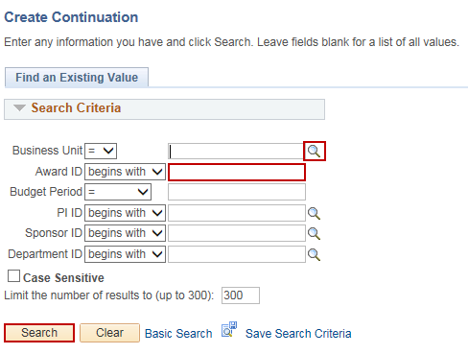
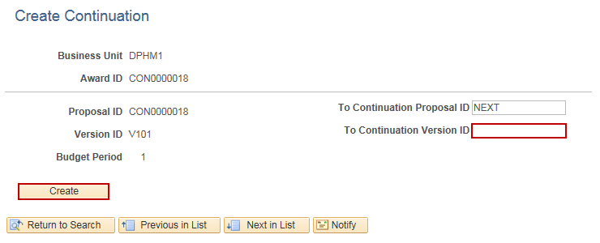
Create a Grant Continuation Proposal
Purpose:
This job aid will help you create a Grant Proposal in Core-CT.
Steps | Screenshots
Navigate to the Create Continuation page: Main Menu > Core-CT Financials > Grants > Awards > Create Continuation
Use the lookup icon to select a valid Business Unit. Enter a valid Award ID or enter any other search criteria. Click the Search button.
Optional: Enter in a new Proposal ID for the continuation in the To Continuation Proposal ID field. Enter a Version ID in the To Continuation Version ID field. Click the Create button.

Slide 2
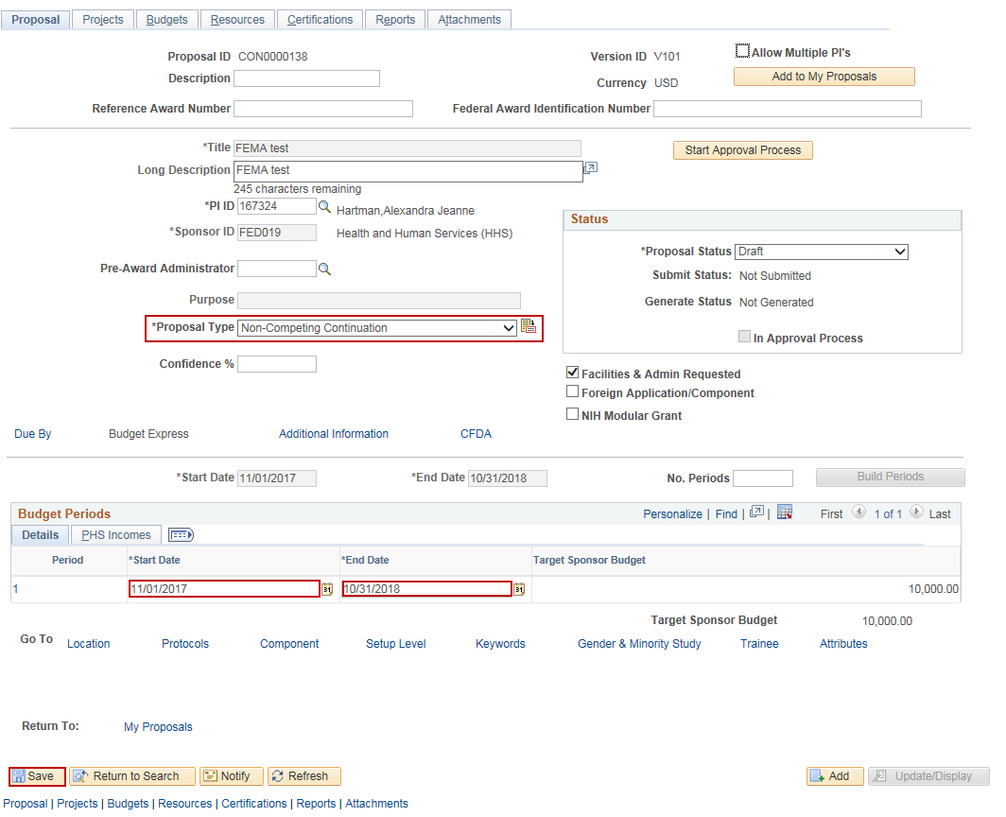
Create a Grant Continuation Proposal
Steps | Screenshots
The Maintain Proposal page is displayed for the Continuation Proposal. The Proposal Type displays Non-Competing Continuation. In the Budget Periods section, update the Start Date and End Date for the continuation. Click the Save button. Navigate to the Projects, Budgets and Resources tabs and update any information for the continuation.

