Slide 1
PeopleSoft Grants Module:
Key Features
11/08/17

Slide 2

Grants Module Delivered Functionality and Benefits
  Features
    Manage the complete grant life cycle from proposals to award including workflow and approvals
    Setup award from proposal including budget, revenue and billing, etc
    Establish and track milestones
    Process facilities and administration costs
    Process bills for cash and letter of credit awards
    Generate standard financial reports (e.g. SPF-425 Federal Financial Report)
    Capture profile data about your State agency, sponsors/grantors, grantees, etc
    Facilitates the submissions of PHS proposal applications & forms
    Grants WorkCenter
    Support award closeout
  Benefits
    Reduces duplicate entry and paper based processes
    Single repository of proposals and awards
      Improves Agency and Statewide data analysis capabilities
      Improves Agency and Statewide transparency
    Builds upon existing Core-CT modules such as AR/Billing and Project Costing
      Integrates with Project Costing for cost collections and budgeting
      Integrates with AR, Billing, Contracts for Billing and Revenue
    Ability to copy previous proposals for continuation, resubmission, etc
    Enforces a standard business process

Slide 3
Demo Topics:
  Entering Basic Proposal Data
  Generate the Award Button
  Managing Awards
  Reports
  Forms
  Grants WorkCenters
  Copy Proposal

Slide 4
Demo:
Entering Basic Proposal Data

Slide 5

In this demo…
The following slides highlight ( ) the required fields for creating a proposal.
Any additional information added will only benefit users as the proposal goes through approval workflow, is awarded, proceeds through completion and requires reporting.
Asterisks seen in the screenshots, that are NOT highlighted, may not be required for creating the proposal, but may be required to complete and interface with federal forms (e.g., SF-424).

Slide 6
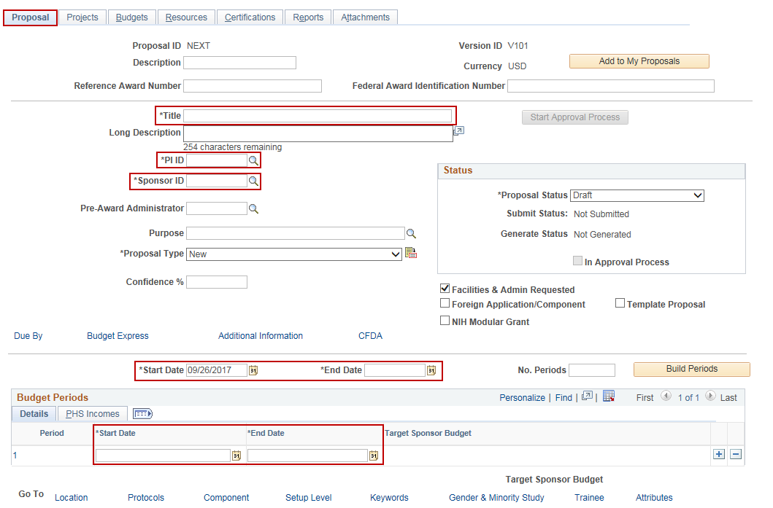
Proposal Tab
Notes:
Note: If you enter the top Start and End Date and Number of Periods and click the Build Periods button, the Budget Periods sub-section will populate for you.

Slide 7
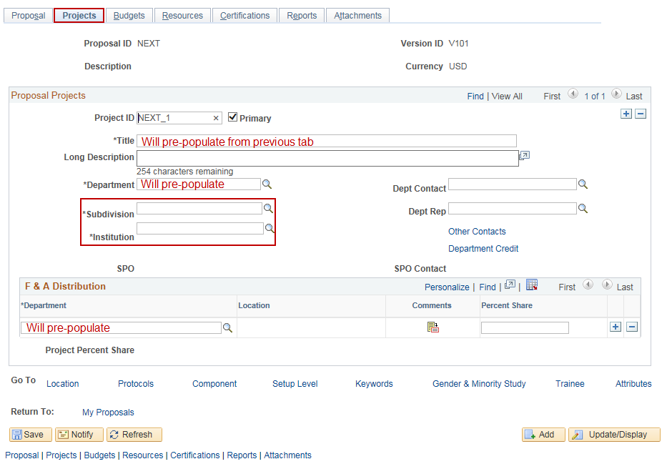
Projects Tab

Slide 8
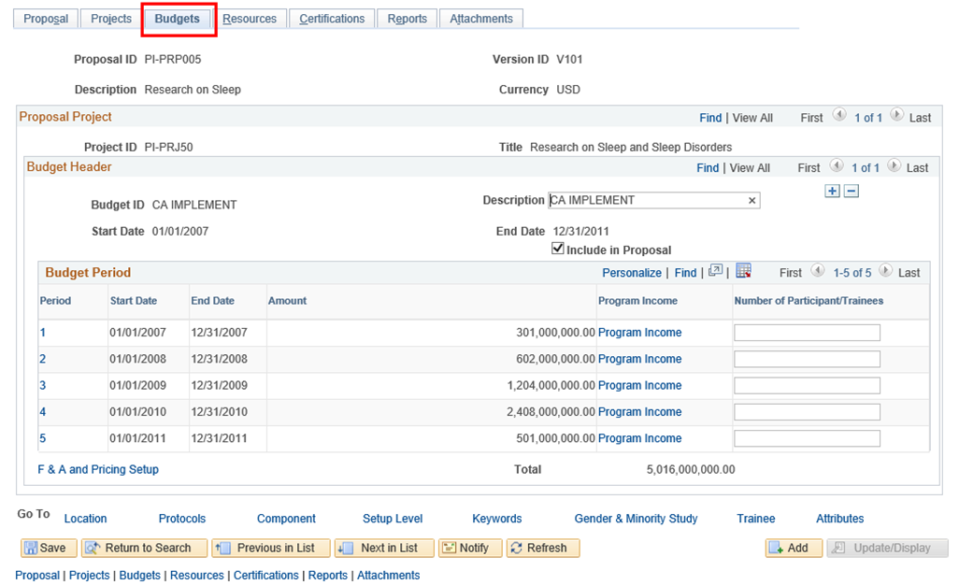
Budgets Tab
Entering Detailed Budget is not required. However, any Budget Data enter on this page will automatically load into KK and Projects.
Notes:
Note: While entering a budget at this stage is not a required field, entering it will be required by any approver. (Click the “1” hyperlink under the Budget Period section and add Budget Items.)

Slide 9
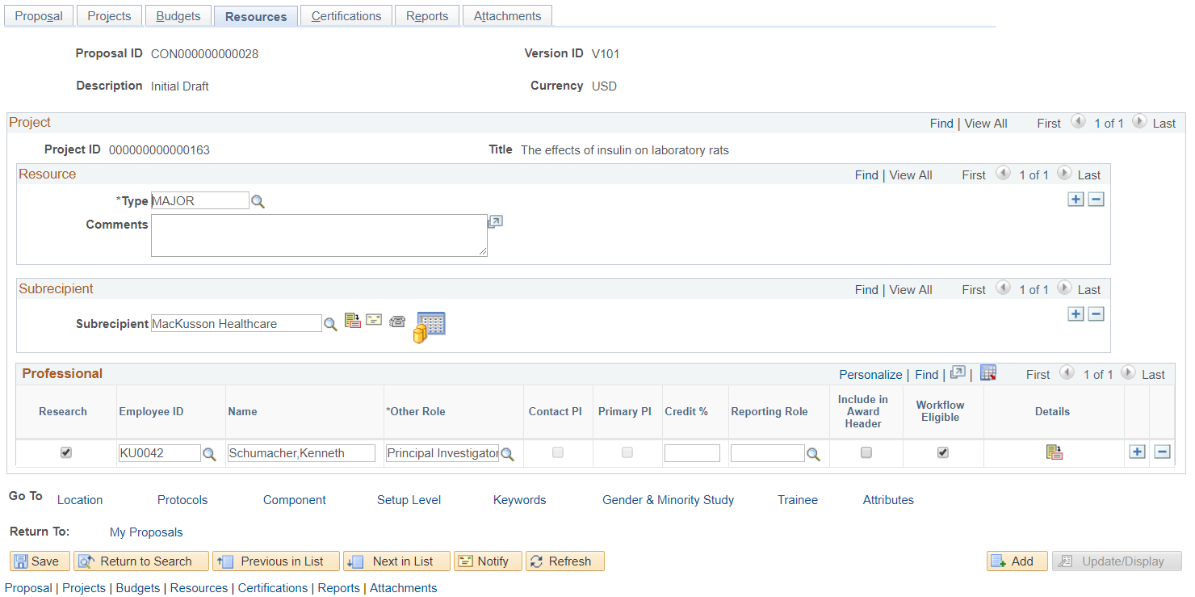
Resources Tab
While entering Professionals at this stage is not a required field, entering it will be required by any approver and will enable the workflow. Any additional Resources Data entered will be used for reporting and tracking in post-award
Notes:
Note: While entering Professionals at this stage is not a required field, entering it will be required by any approver and will enable the workflow.

Slide 10
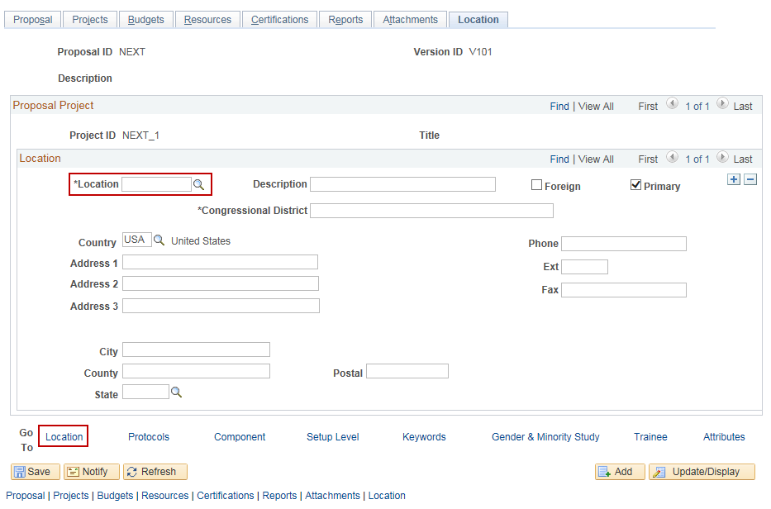
Location Hyperlink
Notes:
Note: Once a Location is selected, the subsequent fields will pre-populate.

Slide 11
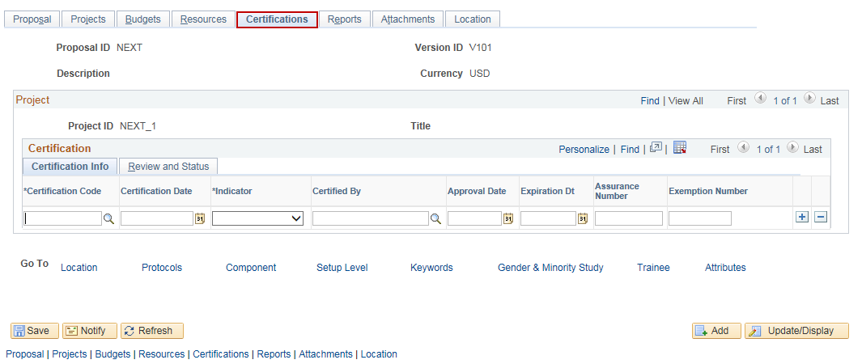
Certifications Tab
Notes:
Note: This tab is not required to create a proposal.

Slide 12
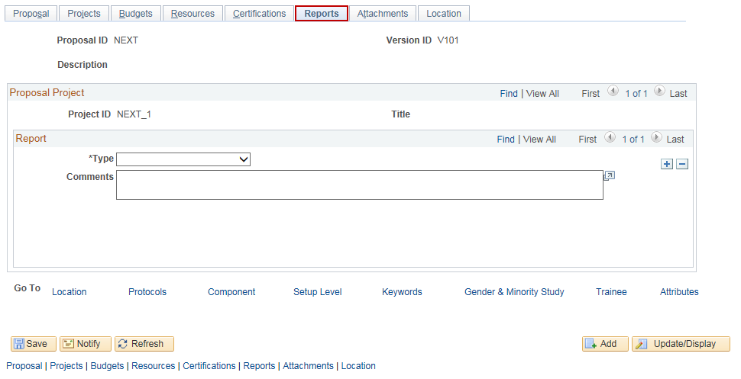
Reports Tab
Notes:
Note: This tab is not required to create a proposal.

Slide 13
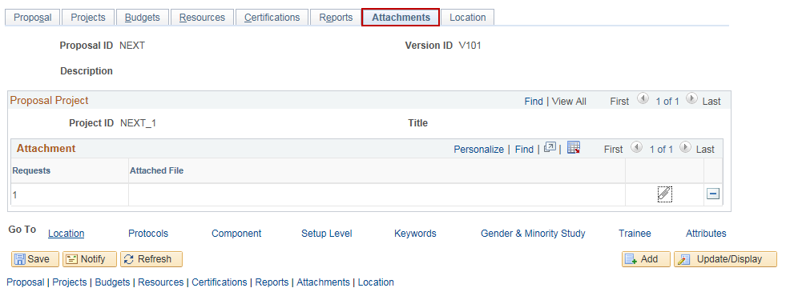
Attachments Tab
Notes:
Note: This tab is not required to create a proposal.

Slide 14
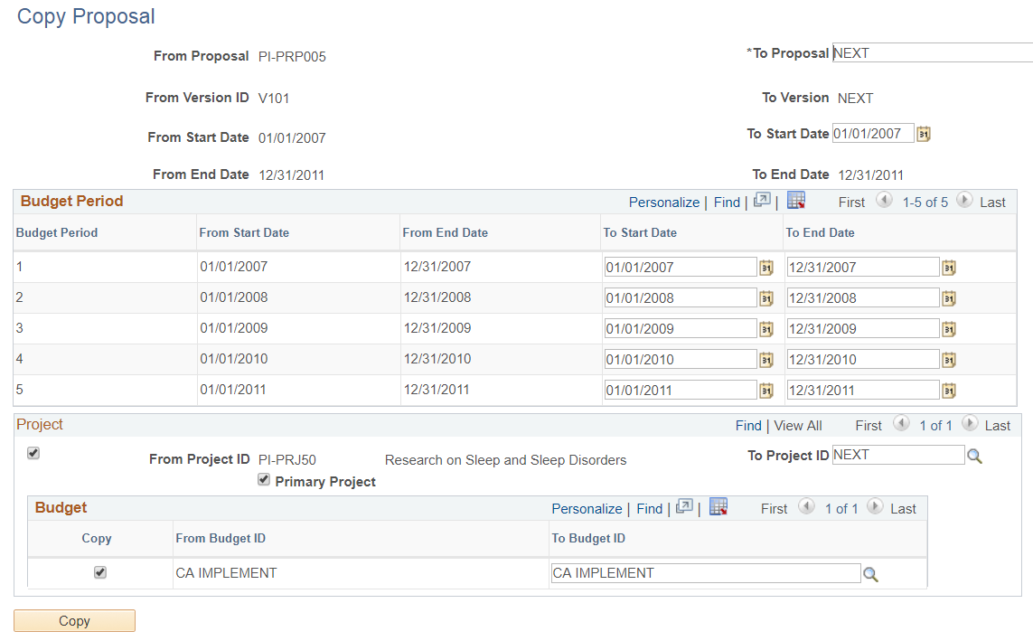
Copy Proposal
You can copy proposal data without re-entering data. Helpful with non-competing application, resubmission and continuation
Notes:
Note:

Slide 15
Demo: Post-Award Features
  Generate Award
  Reports
  Forms
  WorkCenters

Slide 16
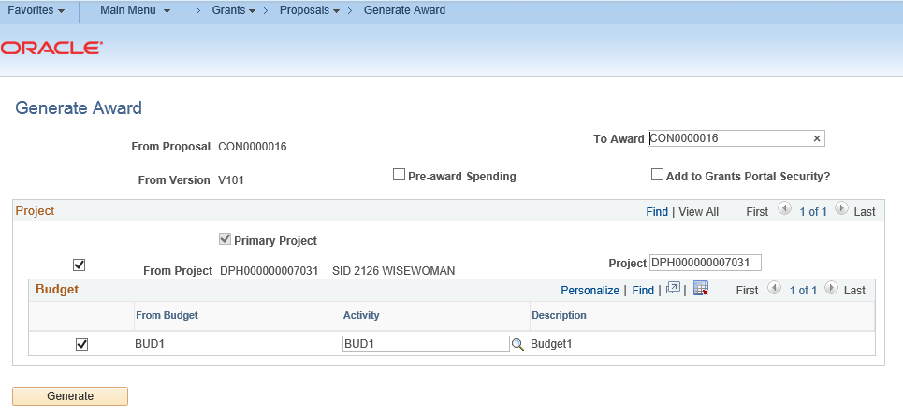
Generate an Award: Illustration
Your Project and Contract are automatically created by this button.

Slide 17
PS Standard Grants Forms
You can use Grants module to fill standard, federal forms:
  Grants Application (PHS-398)
  Non-Competing Grants Progress Report (PHS-2590)
  Federal Financial Report (SF-425)
  Biosketch
Notes:
Note:

Slide 18
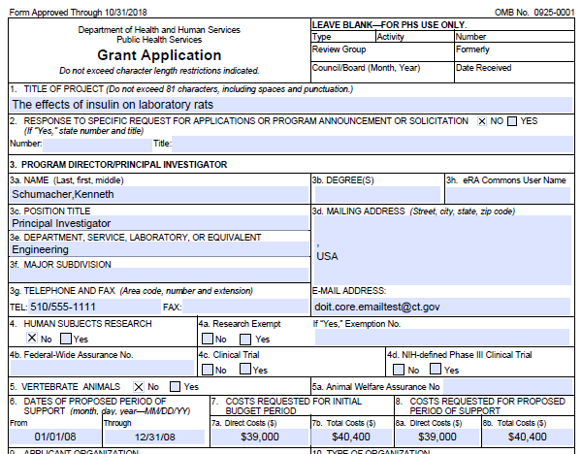
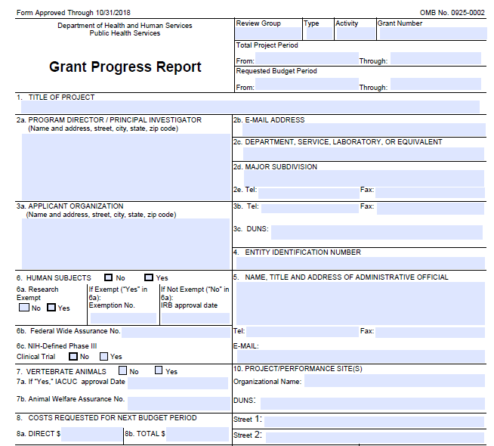
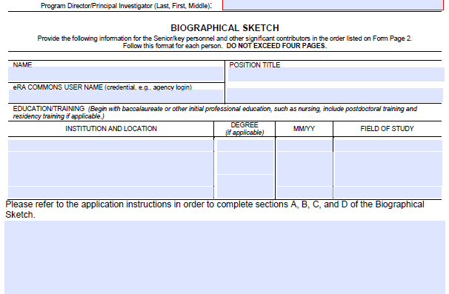
PS Standard Fed Grants Forms: Illustration
PHS 2590
PHS 398
PHS Biosketch

Slide 19
Reporting & Analysis

Slide 20
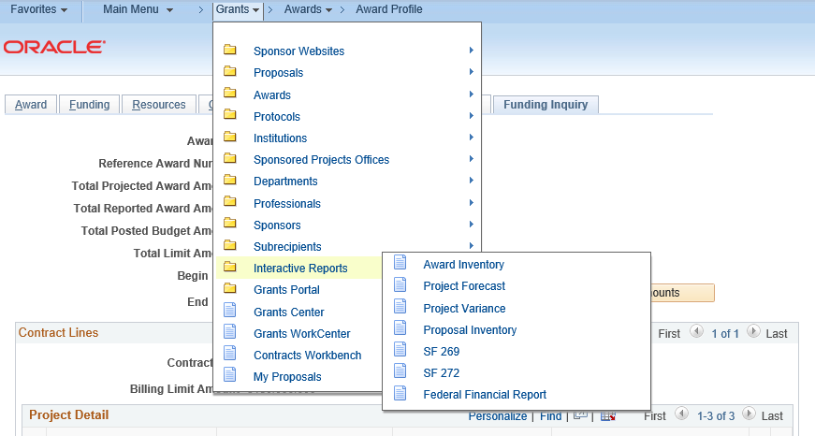
Reporting & Analysis
PS Grants Delivered Interactive Reports allow for dynamic Real Time analysis
  Proposal Inventory
  Award Inventory
  Federal Financial Report (FFR SF425)
  Project Forecast
Notes:
Does not interface with Grants.gov or other Sponsors’ portal

Slide 21
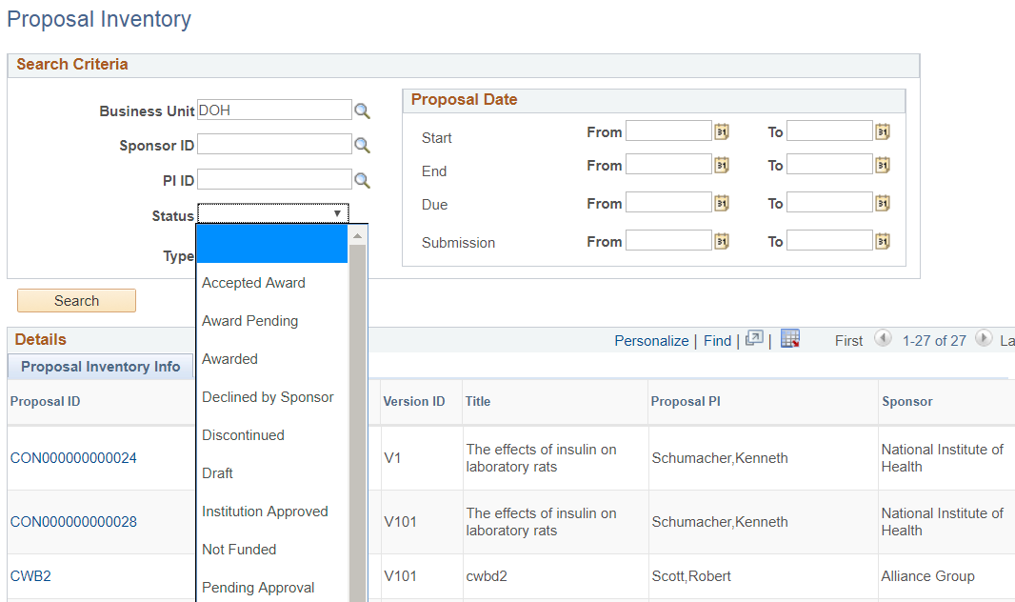
Reports: Illustration
Proposal Inventory: List all your pending proposals across your agency.
Allows users to see status of all Proposals within your agency

Slide 22
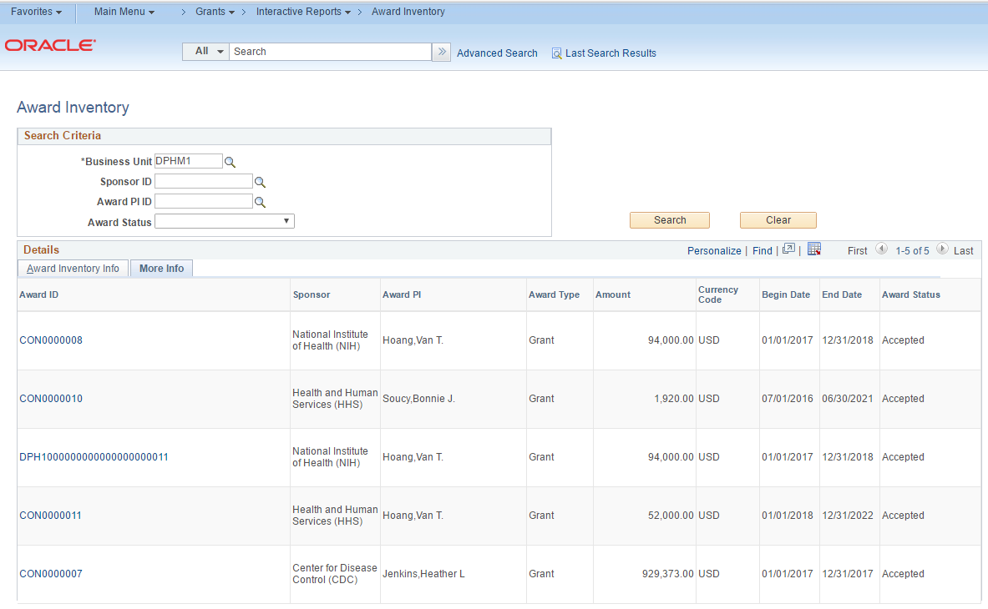
Reports: Illustration
Award Inventory Report: List all your funded awards across your agency

Slide 23
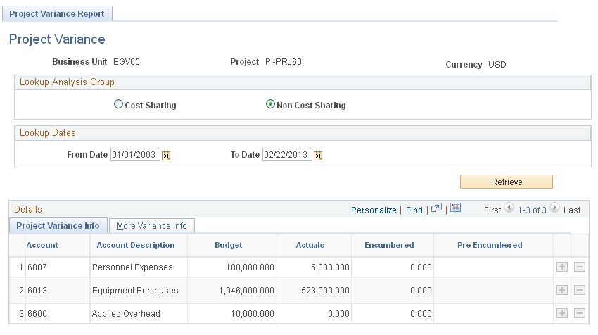
Reports: Illustration
Project Variance: Account level comparison of Budget, Actuals and Encumbered.

Slide 24
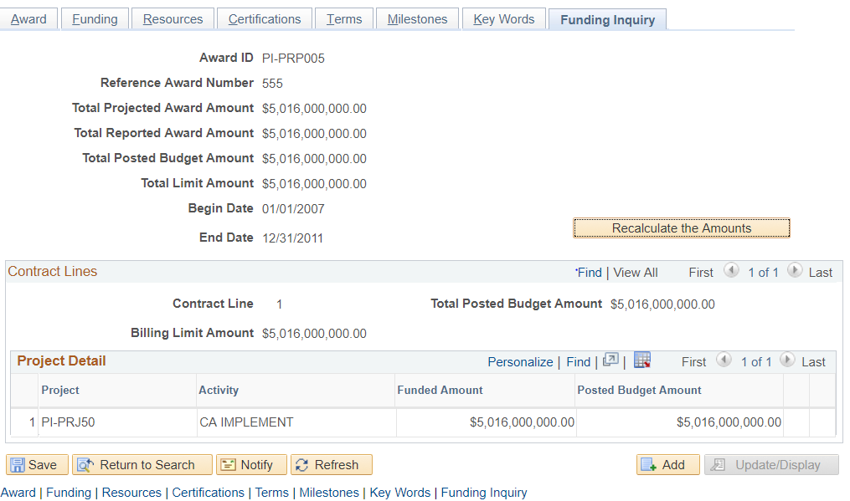
Reports: Illustration
Funding Inquiry: Shows Award funding information

Slide 25
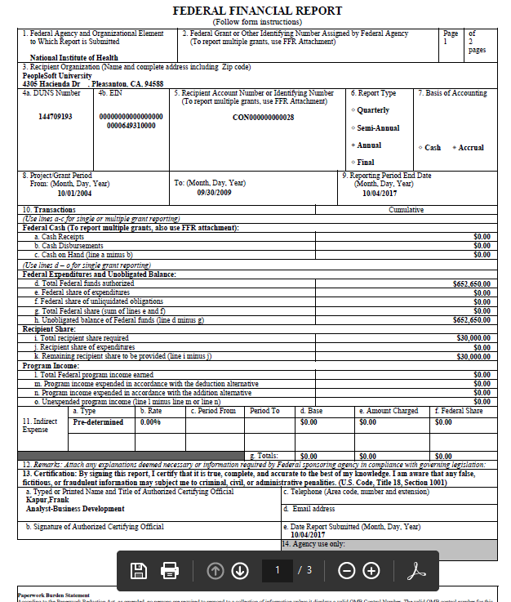
Reports: Illustration
Federal Financial Report (SF425): Provides info that federal agencies require annually. Eg cash drawdown, unobligated balance

Slide 26
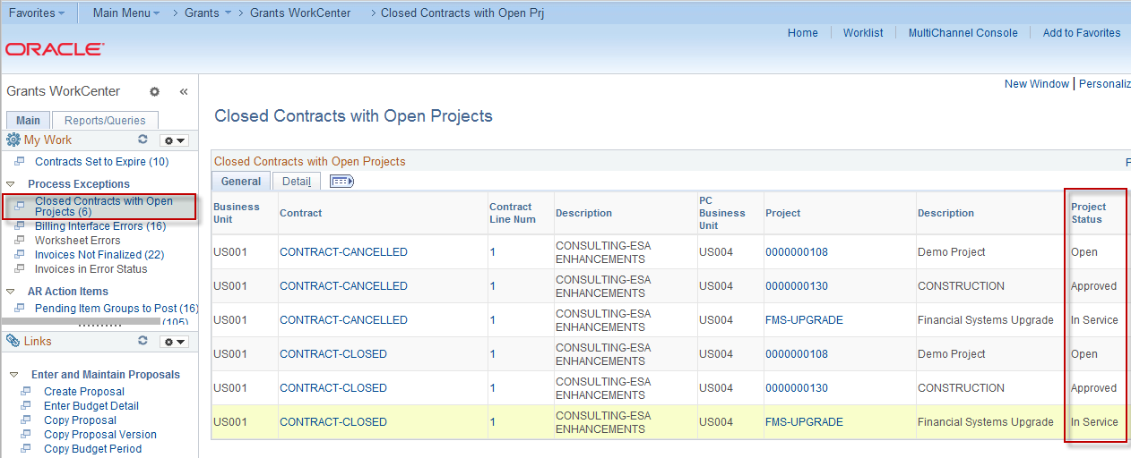
Grants WorkCenter
Helps you to become more efficient by accessing frequently used pages and providing a central area for you to access key transactional data
Notes:
Note:

Slide 27
F&A Processing

Slide 28
Facilities & Admin Processing
Delivered F&A Process automatically calculates F&A costs based on actual expense transaction amounts, F&A bases and F&A rates
F&A Processing will be nightly batch process
Grants module also offers F&A Adjustment feature that enables users to process F&A adjustments based on new or updated F&A bases and F&A rates
  Next slides will illustrate Retroactive F&A Processing
Notes:
Does not interface with Grants.gov or other Sponsors’ portal

Slide 29
F&A Processing
F&A Base is setup as Salaries and Wages
Notes:
Does not interface with Grants.gov or other Sponsors’ portal

Slide 30
F&A Processing
F&A process is run for S&W Base at 76%
Notes:
Does not interface with Grants.gov or other Sponsors’ portal

Slide 31
Question and Answer
Vanessa Hoang – Contracts / Grants Lead
Bonnie Soucy – PC Lead
Chuong Pham – Grants Lead (Accenture)
Ally Hartman – Grants Analyst (Accenture)

