Slide 1
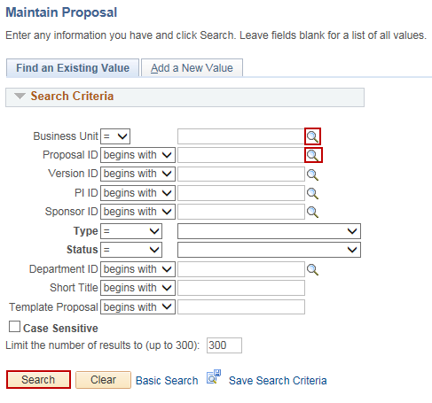
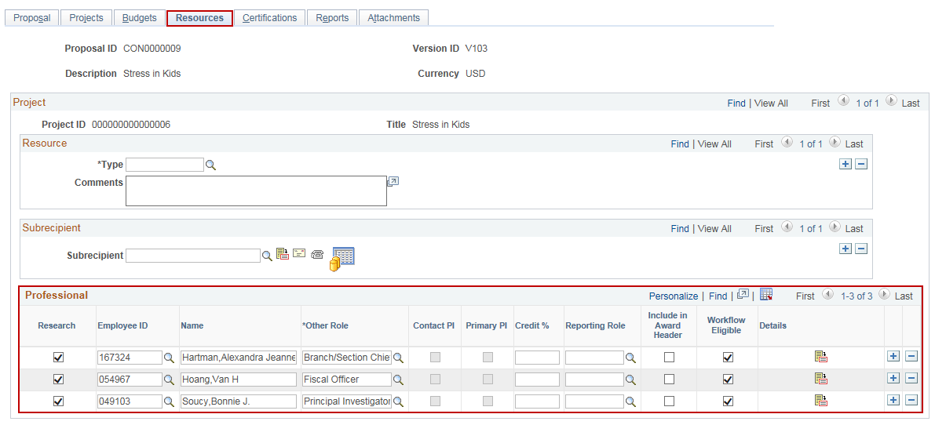
Initiate Workflow
Purpose:
This job aid will help you initiate Workflow for a Grant Proposal in Core-CT.
Steps | Screenshots
Navigate to the Maintain Proposal page: Main Menu > Core-CT Financials > Grants > Proposals > Maintain Proposal
Use the lookup icon to select a valid Business Unit. Use the lookup icon to select a valid Proposal ID or enter any other search criteria. Click the Search button.
Click on the Resources tab and verify that the accurate Professionals are included as Workflow Eligible.

Slide 2
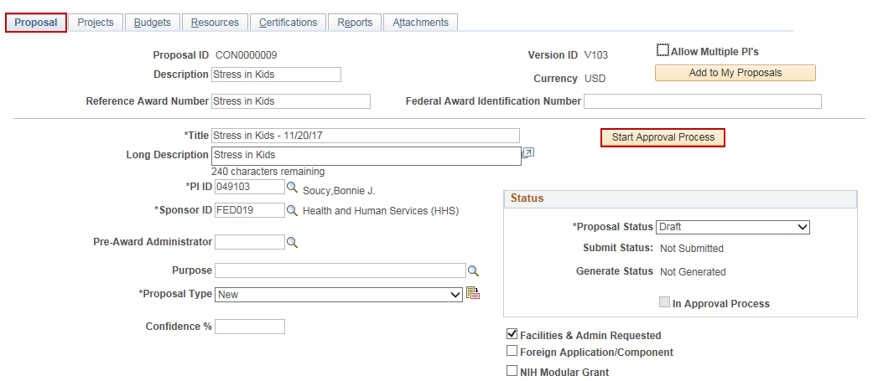
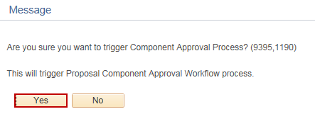
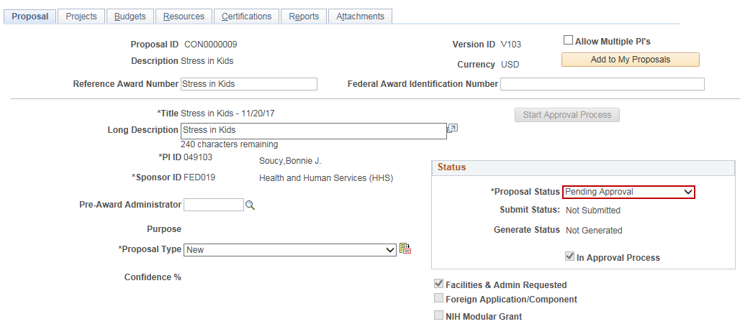
Initiate Workflow
Steps | Screenshots
Click on the Proposal tab. Click on the Start Approval Process button.
Click the Yes button in the popup message.
The Proposal Status displays Pending Approval and the proposal fields are locked for editing.

