Slide 1
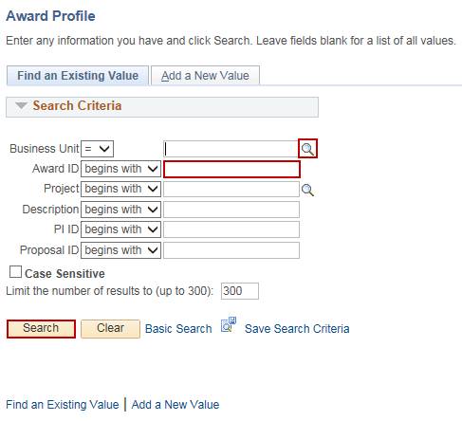
Milestone Notification
Purpose:
This job aid will help you notify an employee of an upcoming milestone.
Steps | Screenshots
Navigate to the Award Profile page: Main Menu > Core-CT Financials > Grants > Awards > Award Profile
Use the lookup icon to select a valid Business Unit. Enter a valid Award ID or enter in any other search criteria. Click the Search button.
Click on the Milestones tab. Use the lookup icon to select the Milestone Type. Use the lookup icon to select the Milestone Code. Select the Milestone Priority from the dropdown menu. Use the Calendar icon to select a Due Date. Enter an amount of Days Prior to Notify.

Slide 2
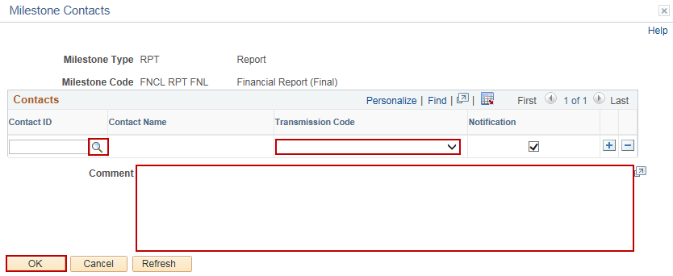
Milestone Notification
Steps | Screenshots
Click the Detail tab. Click the Contact ID hyperlink to select employees to notify of the milestone.
Click the Contact ID lookup icon to select an employee. Select a Transmission Code from the dropdown menu. Enter Comments about the milestone. Click the OK button.

Slide 3
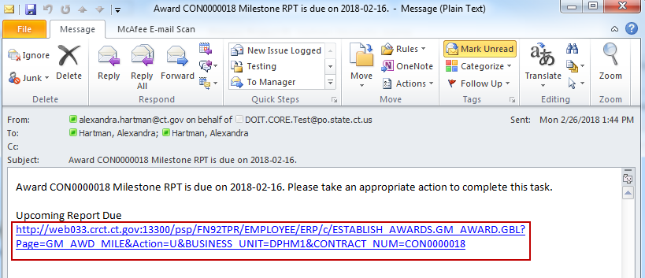
Milestone Notification
Steps | Screenshots
Click the “+” button to add additional employees to notify. Click the Notify button.
Click the Yes button in the popup message.
The employee will receive an email notification that a milestone is due. Click on the hyperlink to view the notification.

Slide 4
Milestone Notification
Steps | Screenshots
Click the lookup icon to select a Milestone Status of In Progress or Completed. Click the Save button.
Once the milestone has been marked Completed, the Detail tab will display the Completion Date, Completed By and Name.

