Slide 1
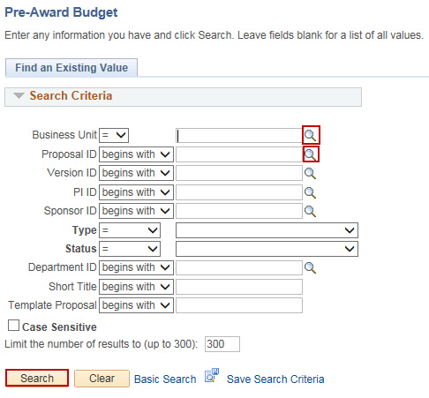
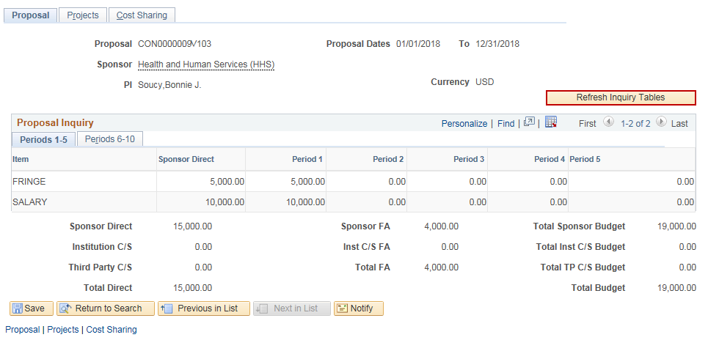
Review Pre-Award Budget
Purpose:
This job aid will help you view the pre-award budget for a Grant Proposal in Core-CT.
Steps | Screenshots
Navigate to the Review Pre-Award Budget page: Main Menu > Core-CT Financials > Grants > Proposals > Review Pre-Award Budget
Use the lookup icon to select a valid Business Unit. Use the lookup icon to select a Proposal ID or enter in any other search criteria. Click the Search button.
Click the Refresh Inquiry Tables button to refresh the tables.

Slide 2
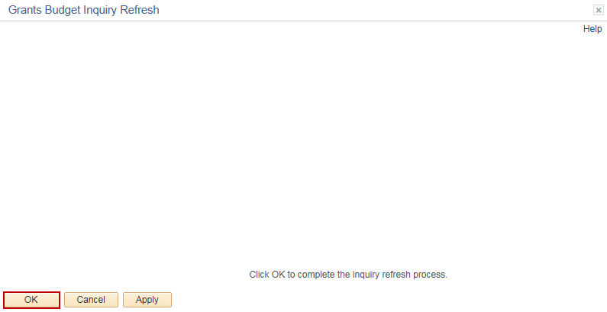
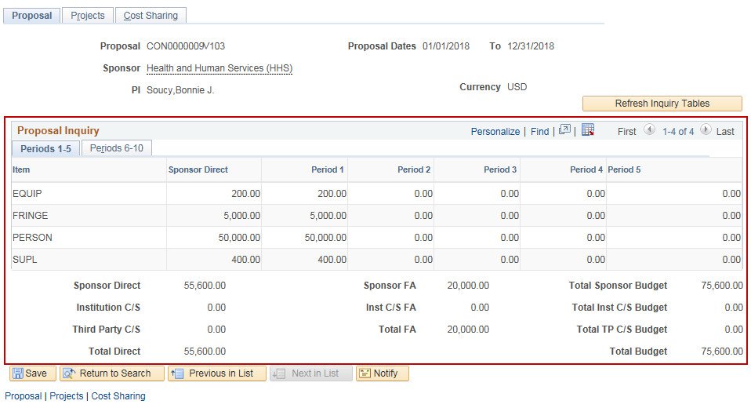
Review Pre-Award Budget
Steps | Screenshots
Click the OK button in the popup message.
Review the budget information.

Slide 3
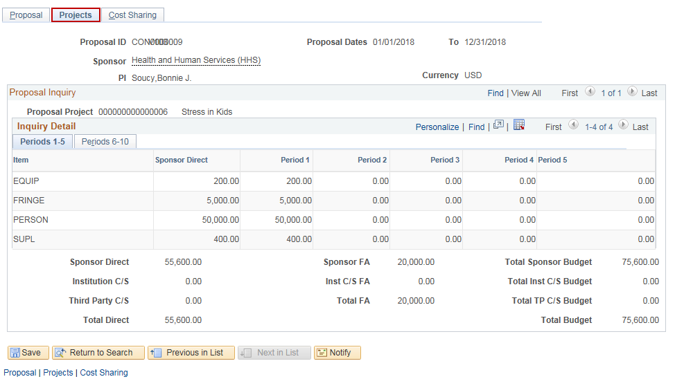
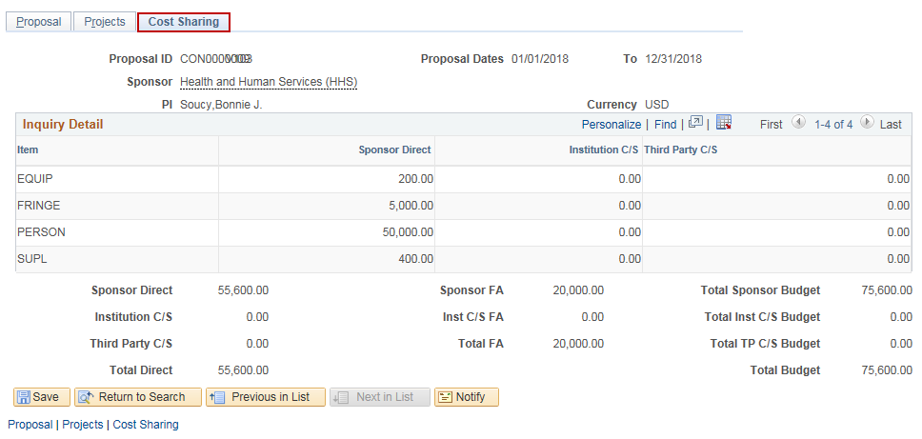
Review Pre-Award Budget
Steps | Screenshots
Click on the Projects tab to view the budgets by project.
Click on the Cost Sharing tab to view cost sharing information.

