Slide 1
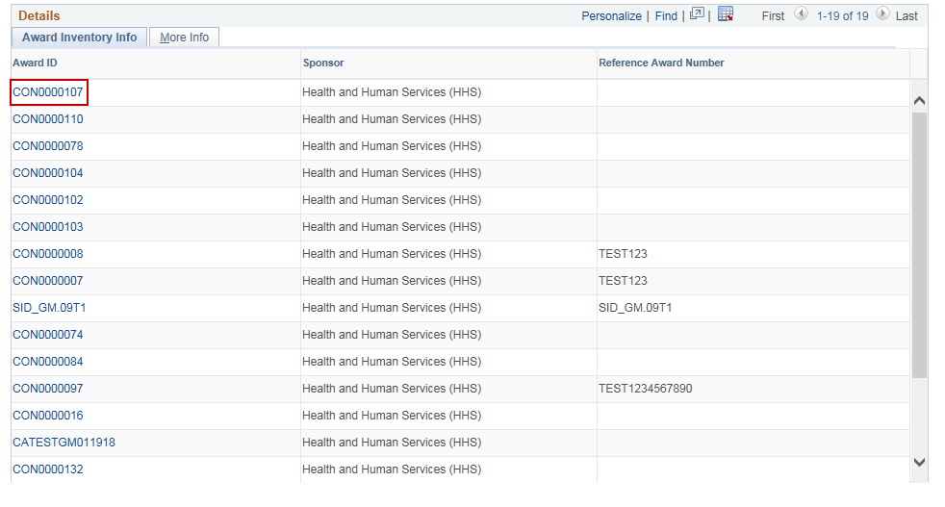
Run Financials Reports
Purpose:
This job aid will help you run different Grants Financials Reports in Core-CT.
Steps | Screenshots
1. To view the Award Inventory, navigate to the Award Inventory page: Main Menu > Core-CT Financials > Grants > Interactive Reports > Award Inventory
Use the lookup icon to select a valid Business Unit. Click the Search button.
Click on the Award ID hyperlink to view a particular proposal.

Slide 2
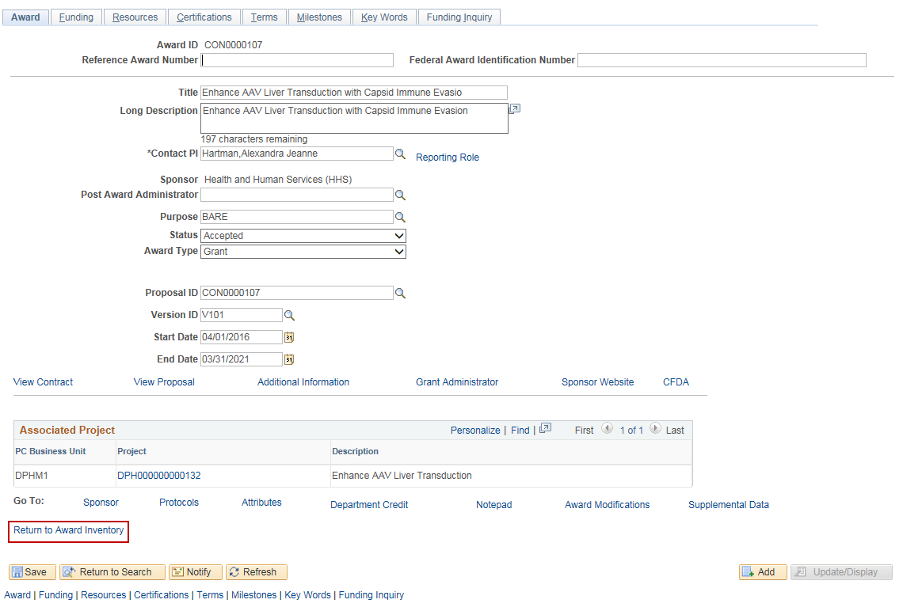
Run Financials Reports
Steps | Screenshots
Click on the Return to Award Inventory hyperlink.
Click on the More Info tab to view more information about the Award.

Slide 3
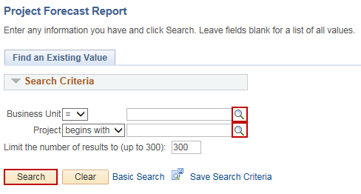
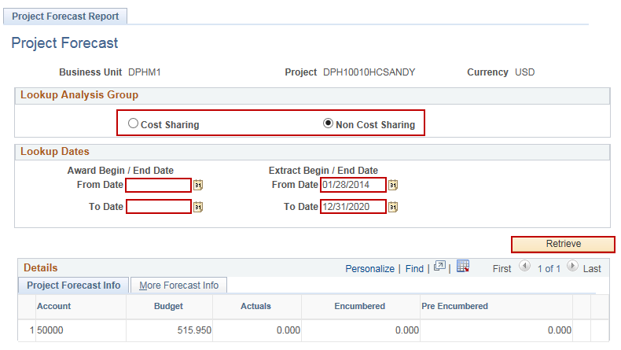
Run Financials Reports
Steps | Screenshots
1. To view the Project Forecast Report, navigate to the Project Forecast page: Main Menu > Core-CT Financials > Grants > Interactive Reports > Project Forecast
Use the lookup icon to select a valid Business Unit. Optional: Enter a Project, if known. Click the Search button.
Click on Cost Sharing or Non Cost Sharing radio button. Enter Award Begin/End Date From Date and To Date and Extract Begin/End Date From Date and End Date. Click the Retrieve button.
Click on the More Forecast Info tab to view more information.

Slide 4
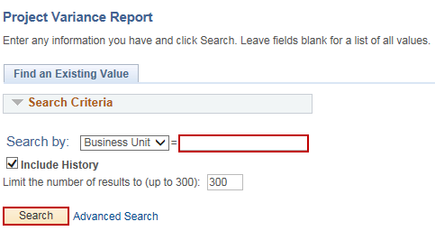
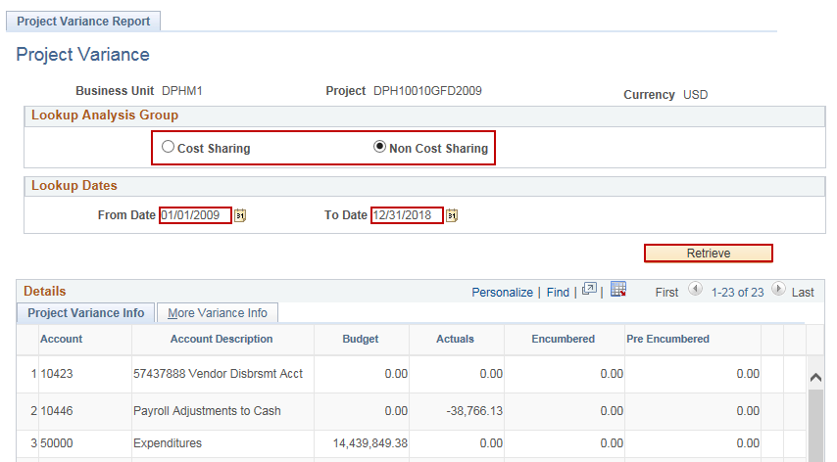
Run Financials Reports
Steps | Screenshots
1. To view the Project Variance Report, navigate to the Project Forecast page: Main Menu > Core-CT Financials > Grants > Interactive Reports > Project Variance
Enter a valid Business Unit. Click the Search button. Select the Project.
Click on Cost Sharing or Non Cost Sharing radio button. Enter From Date and To Date. Click the Retrieve button.
Click on the More Variance Info tab to view more information.

Slide 5
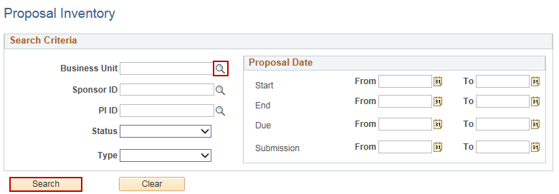
Run Financials Reports
Steps | Screenshots
1. To view the Proposal Inventory, navigate to the Project Inventory page: Main Menu > Core-CT Financials > Grants > Interactive Reports > Proposal Inventory
Use the lookup icon to select a valid Business Unit. Optional: Enter in any other Search criteria. Click the Search button.
Click on the Proposal ID hyperlink to view a particular proposal.

Slide 6
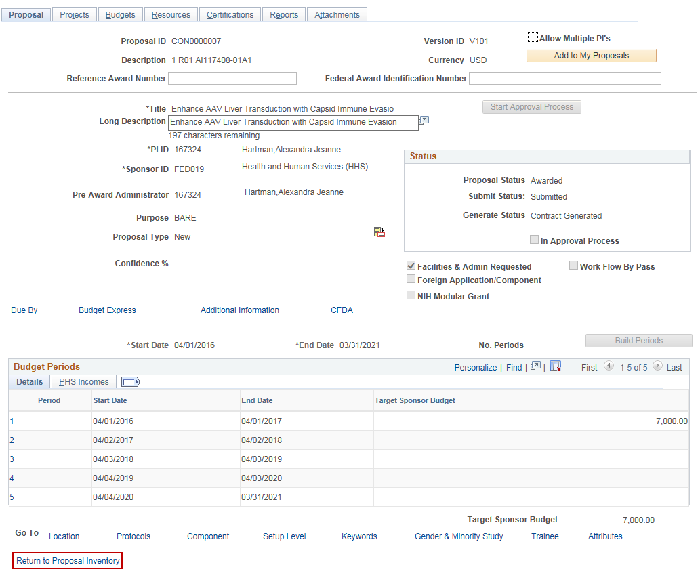
Run Financials Reports
Steps | Screenshots
Click on the Return to Proposal Inventory hyperlink.
Click on the More Info tab to view more information about the proposal.

Slide 7
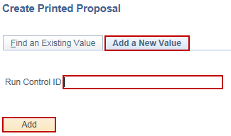
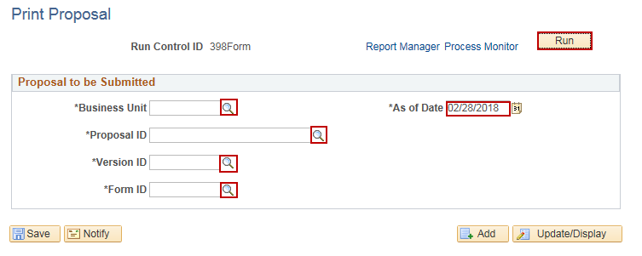
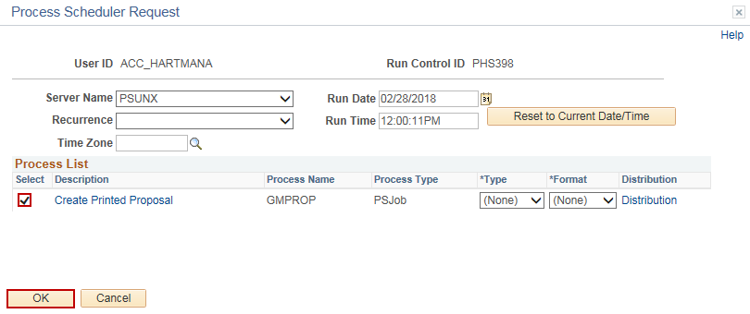
Run Financials Reports
Steps | Screenshots
1. To run the PHS 398 Report, navigate to the Print Proposal page: Main Menu > Core-CT Financials > Grants > Proposals > Print Proposal
Click on the Add a New Value tab. Enter a valid Run Control ID. Click the Add button.
Use the lookup icons to select a Business Unit, Proposal ID, Version ID, Form ID and As Of Date. Click the Run button.
Verify that the Create Printed Proposal process is checked. Click the OK button.

Slide 8
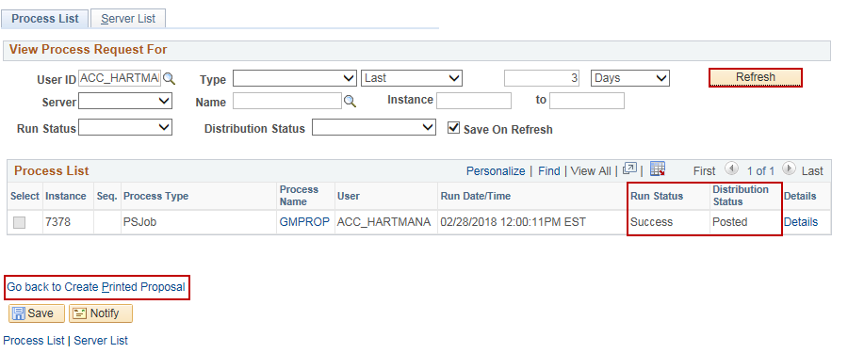
Run Financials Reports
Steps | Screenshots
Note the Process Instance Number. Click on the Process Monitor hyperlink.
Optional: Click the Refresh button until the Run Status displays Success and the Distribution Status displays Posted. Click the Go back to Create Printed Proposal hyperlink.
Click on the Report Manager hyperlink.

Slide 9
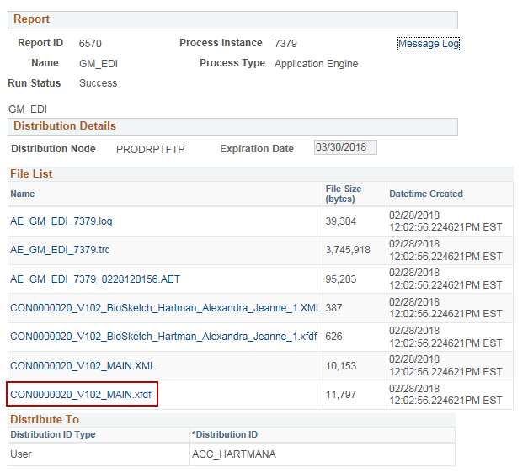
Run Financials Reports
Steps | Screenshots
Click on the GM_EDI hyperlink for the report row.
Click on the file that lists the ContractNumber_VersionNumber_MAIN.xfdf hyperlink.

Slide 10
Run Financials Reports
Steps | Screenshots
The blank report will open in a new browser window. In the opened report tab, click on the ! icon on the left.
In the yellow popup, click the Options button. Click the Trust this document one time only option. The report values will fill into the report.
Click the floppy disk icon in the top left corner of the report to Save the document or click the printer icon to Print the document.

Slide 11
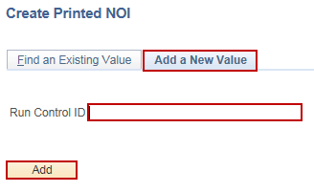
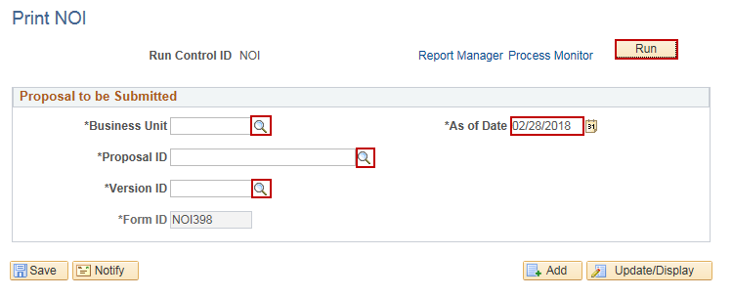
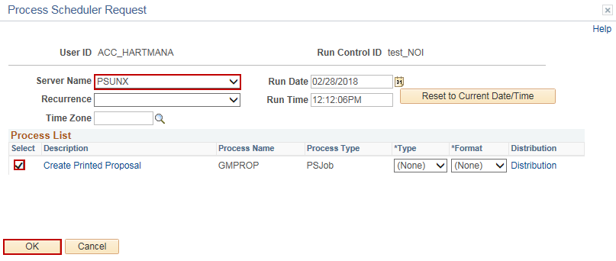
Run Financials Reports
Steps | Screenshots
1. To run the State of Connecticut Notice of Intent Report, navigate to the Print NOI page: Main Menu > Core-CT Financials > Grants > Proposals > Print NOI
Click on the Add a New Value tab. Enter a valid Run Control ID. Click the Add button.
Use the lookup icons to select a Business Unit, Proposal ID, Version ID and As Of Date. Click the Run button.
Verify that the Create Printed Proposal process is checked. Select PSUNX in the Server Name dropdown menu. Click the OK button.

Slide 12
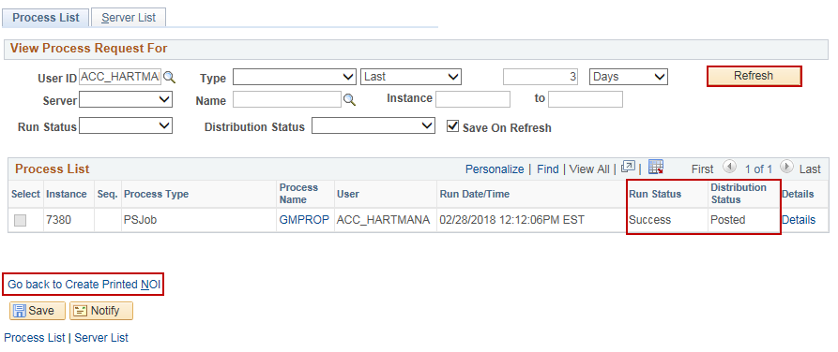
Run Financials Reports
Steps | Screenshots
Note the Process Instance Number. Click on the Process Monitor hyperlink.
Optional: Click the Refresh button until the Run Status displays Success and the Distribution Status displays Posted. Click the Go back to Create Printed NOI hyperlink.
Click on the Report Manager hyperlink.

Slide 13
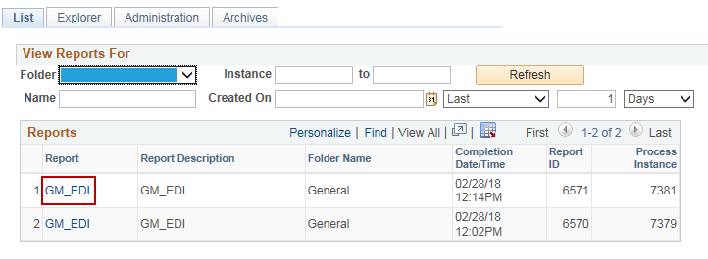
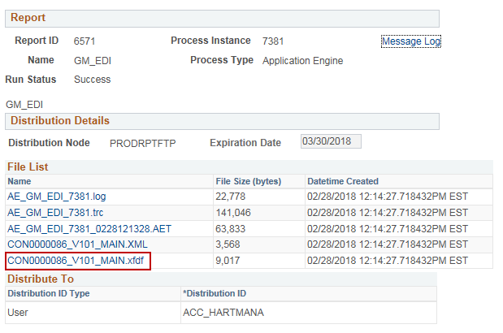
Run Financials Reports
Steps | Screenshots
Click on the GM_EDI hyperlink for the report row.
Click on the file that lists the ContractNumber_VersionNumber_MAIN.XFDF hyperlink.
The blank report will open in a new browser window. In the opened report tab, click on the ! icon on the left.

Slide 14
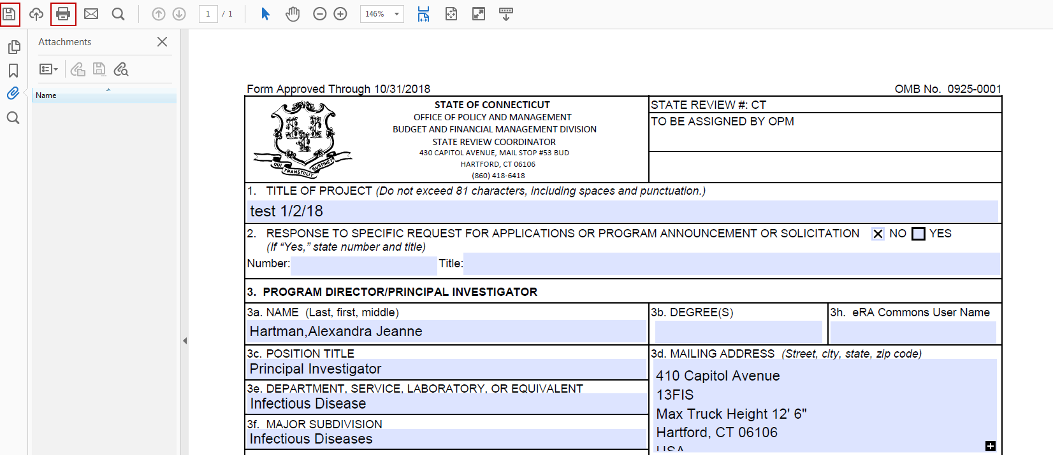
Run Financials Reports
Steps | Screenshots
In the yellow popup, click the Options button. Click the Trust this document one time only option. The report values will fill into the report.
Click the floppy disk icon in the top left corner of the report to Save the document or click the printer icon to Print the document.

Slide 15
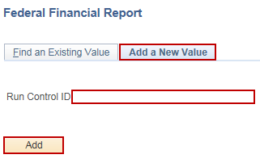
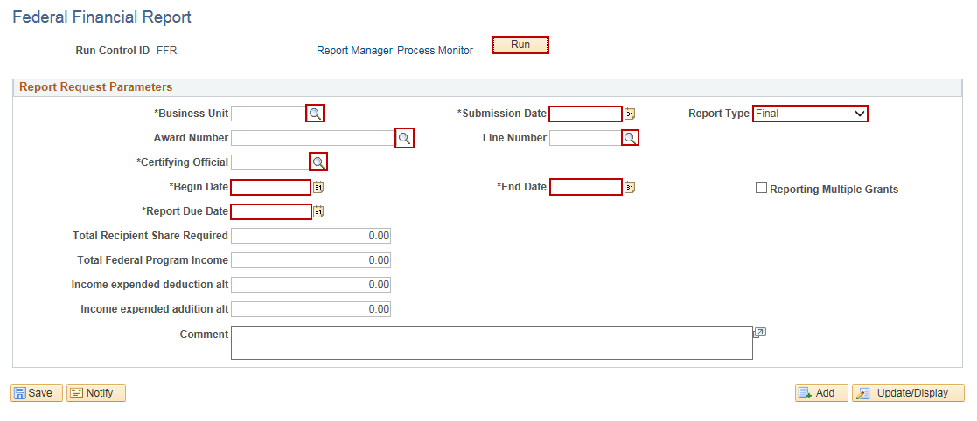
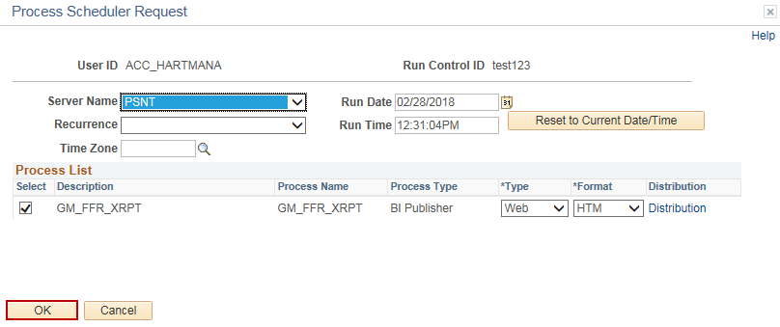
Run Financials Reports
Steps | Screenshots
1. To run the Federal Financial Report, navigate to the Federal Financial Report page: Main Menu > Core-CT Financials > Grants > Interactive Reports > Federal Financial Report
Click on the Add a New Value tab. Enter a valid Run Control ID. Click the Add button.
Use the lookup icons to select a Business Unit, Award Number, Certifying Official, Begin Date, End Date, Report Due Date, Submission Date, Line Number and Report Type. Click the Run button.
Verify that the Create Printed Proposal process is checked. Select PSUNX in the Server Name dropdown menu. Click the OK button.

Slide 16
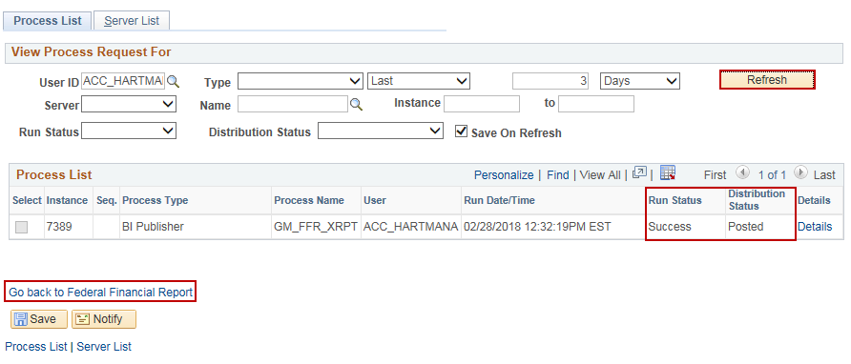
Run Financials Reports
Steps | Screenshots
Note the Process Instance Number. Click on the Process Monitor hyperlink.
Optional: Click the Refresh button until the Run Status displays Success and the Distribution Status displays Posted. Click the Go back to Federal Financial Report hyperlink.
Click on the Report Manager hyperlink.

Slide 17
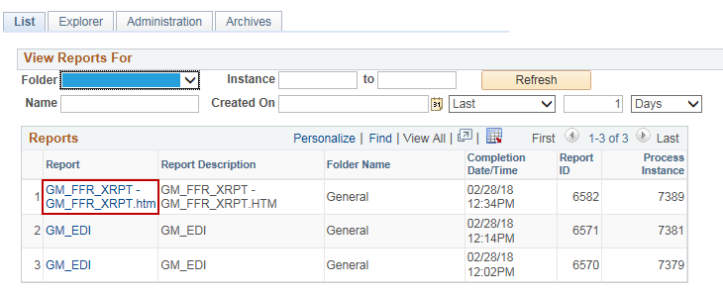
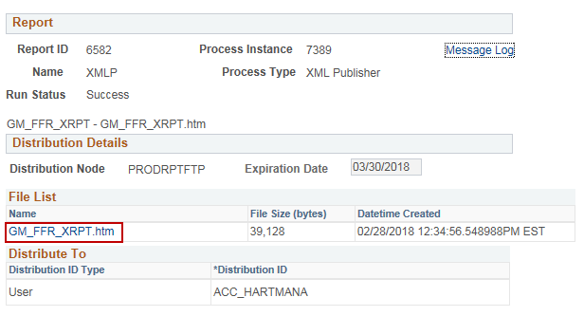
Run Financials Reports
Steps | Screenshots
Click on the GM_FFR_XRPT – GM_FFR_XRPT.htm hyperlink for the report row.
Click on the GM_FFR_XRPT.htm hyperlink.

Slide 18
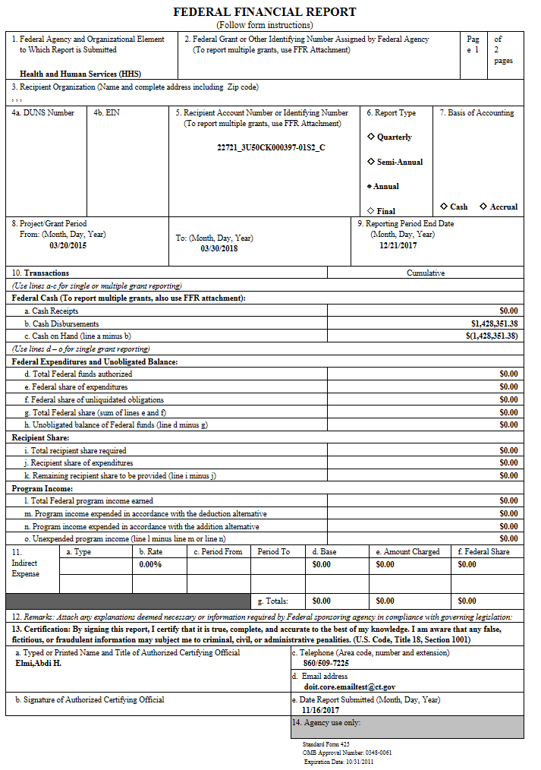
Run Financials Reports
Steps | Screenshots
The report will open in a new browser window tab.

