Slide 1
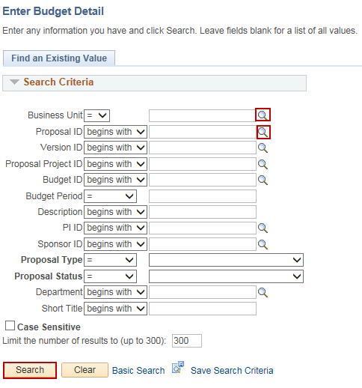
Update Budget
Purpose:
This job aid will help you update a budget for a Grant Proposal in Draft status in Core-CT.
Steps | Screenshots
Navigate to the Budget Detail page: Main Menu > Core-CT Financials > Grants > Proposals > Enter Budget Detail
Use the lookup icon to select a valid Business Unit. Use the Proposal ID lookup to select a valid proposal or enter in other search criteria. Click the Search button.
Click the link for result for the Proposal, Budget ID and Budget Period to update.

Slide 2
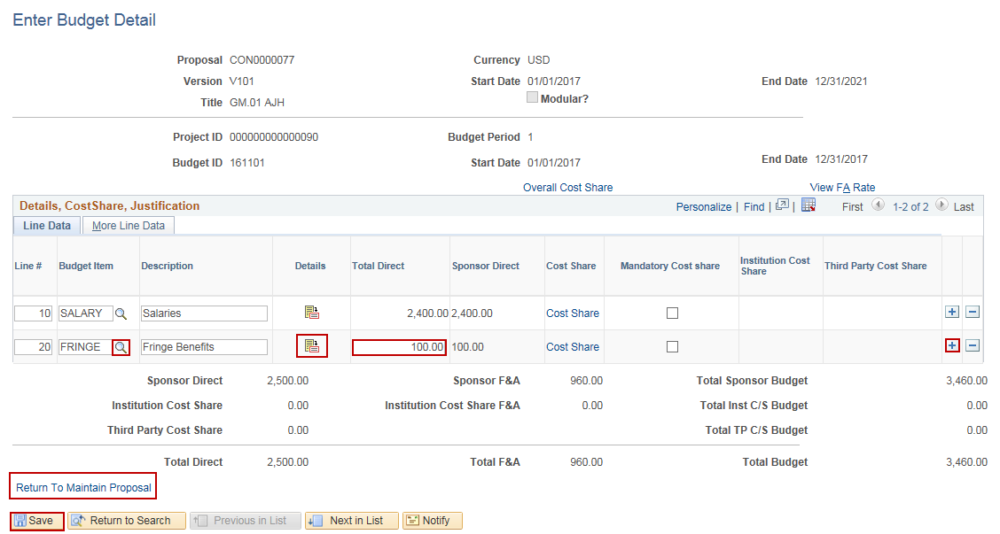
Update Budget
Steps | Screenshots
Click the “+” button to add additional Budget Items. Use the Budget Item lookup icon to select the Budget Item. Click on the Details icon or enter an amount in the Total Direct field. Click the Save button. Click the Return to Maintain Proposal hyperlink to view the proposal.

