Slide 1
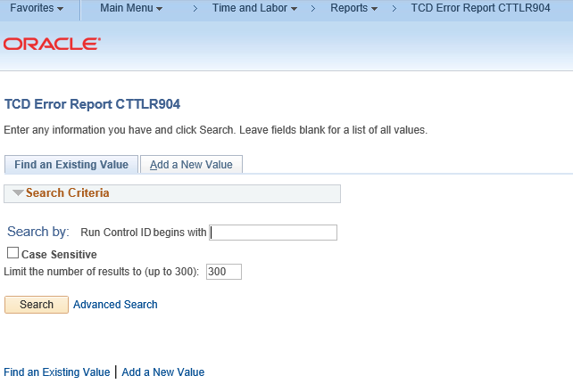
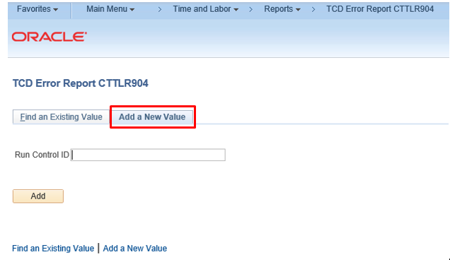
TCD Error Report
Purpose:
The TCD Error Report is for use by TCD agencies as an audit tool to identify those transactions that did not pass TCD file validation. Employees listed on the report will not have the time loaded to the Timesheet. Error correction must be done directly on the Timesheet in Core-CT or in the case of employees inactive in Core-CT time and Labor example leave without pay time is entered on the Adjust Paid Time page
Steps | Screenshots
Main Menu > Core-CT HRMS > Time and Labor > Reports > TCD Error Report CTTLR904
Click the Add a New Value tab

Slide 2
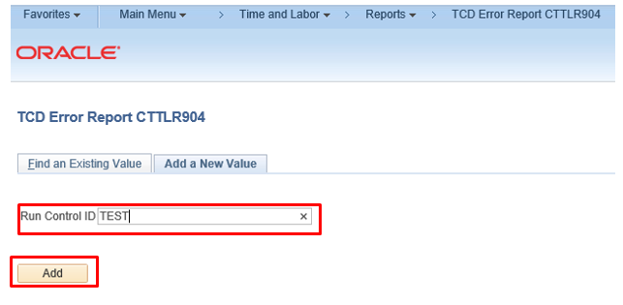
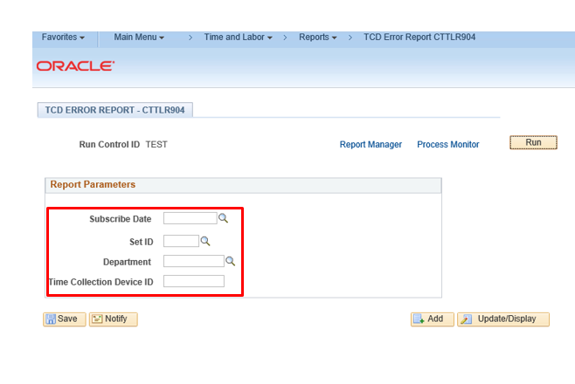
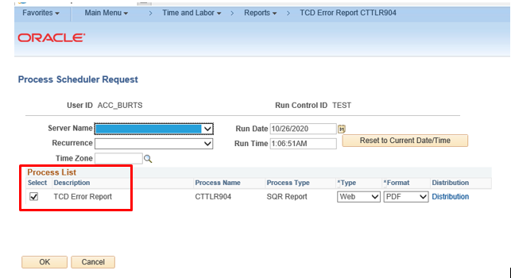
Steps | Screenshots
Enter Run Control ID and click the Add button A Run Control ID is a unique name that will be used to run the report. When the add button is selected the run control value is automatically saved and can be used again by clicking the Find an Existing Value tab
The Report Parameters page is displayed. Enter the following and click the Run button: Subscribe Date – Date TCD file was processed in Core-CT. Core-CT processes files at 10 am and 2 pm Friday, Saturday and Monday. Set ID - AGNCY Department – Department ID associated to file Time Collection Device ID – Three character Agency acronym followed by 001
The Process Scheduler Request page is displayed. Click OK button

Slide 3
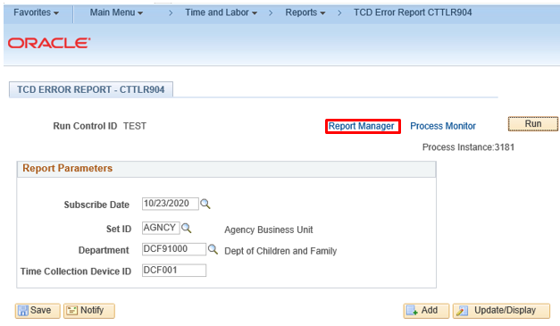
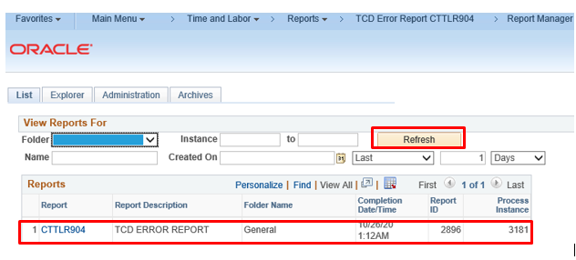
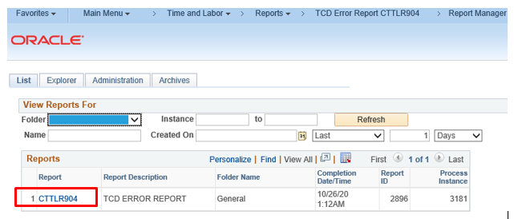
Steps | Screenshots
User is returned to the Report Parameters page. Click on the Report Manager link
Click the refresh button periodically until the report link appears. The Report link will be blank until the report status is posted.
Click on the link under the report column

Slide 4
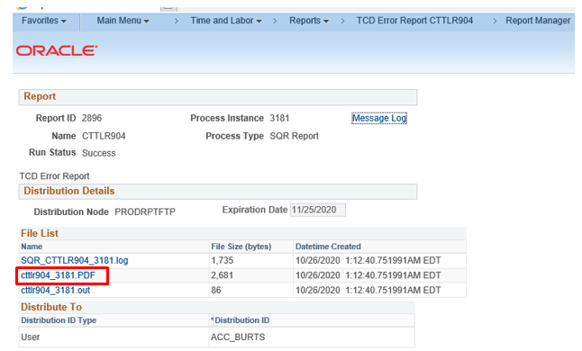
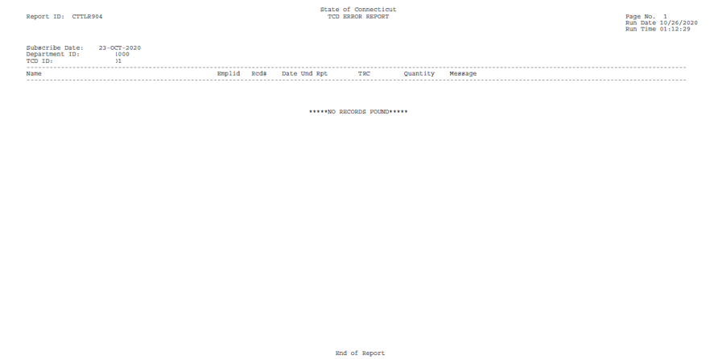
Steps | Screenshots
The Report/Log Viewer page displays. Click name link to view the report

Slide 5
Report Error Message
Invalid Employee ID / Job combination | There is no valid Time Reporter, who is setup with the Employee ID and Record Number (ties to Job) specified. (13500,61)
A blank TRC was found | A Time Reporting Code is required. Records containing blank TRC values are invalid. (20100,12)
Invalid TRC | The Time Reporting Code does not exist in the TRC table. (20100,11)
TCD Department Error | The employee's Department ID does not match the TCD interface ID. (20100,1000)
hen the Add/Delete Indicator is "D", the DELETE_DATE field is required | The Delete Date must be specified to provide the context required to execute the requested Delete function. (13500,63)
When the Add/Delete Indicator is "A", the reporting date[time] field is required | If this is an Elapsed Time message, it is the Date Under Report field (DUR) that is required. (13500,64)
Field is required | You have left a field empty and a value must be entered. (15,8)
Transaction is for a date beyond 60 days in the past | Transactions for dates beyond 60 days in the past are not allowed. (20100,10)

