Slide 1
CT- Stars State Analytical Reporting System
OBI- STARS Payroll
Instructor Guide

Slide 2
Agenda
Course Introduction
Navigate OBI- STARS
Create and Save Analysis
Format Analysis and Columns
Customize Analysis Views
Drill Down Functionality
Search, Print and Export Results
Work with Dashboard Prompts
Build and Design a Dashboard

Slide 3
Topic | Objectives | Duration | From | To
Course Introduction | Intro Training outcome analysis/ Dashboard | 15 minutes | 8:30 AM | 8:45 AM
UPK/Navigate OBI-STARS | UPK Understand OBI- STARS Homepage | 45 minutes | 8:45 AM | 9:30 AM
Break |  | 15 minutes | 9:30 AM | 9:45 AM
Create & Save Analysis | Understand the Analysis Editor View Create a New Analysis Save Filters from Analysis Apply Saved Filters | 90 minutes | 9:45 AM | 11:15 AM
Format Analysis & Columns | Move, Add, Exclude, Hide & Delete Columns Sort a Column Add Totals Edit Column Formats Apply Conditional Format | 45 minutes | 11:15 AM | 12:00 PM
Lunch |  | 30 minutes | 12:00 PM | 12:30 PM
Customize Analysis Views | Type of Views Table Properties Add & Customize a Pivot Table Add and Format a Graph | 45 minutes | 12:30 PM | 1:15 PM
Drill Down Functionality | Work with Existing Analysis Creating Action Link Testing Action Link | 15 minutes | 1:15 PM | 1:30 PM
Search, Print, & Export | Search an Analysis Print Results to PDF Export Results to Excel© | 15 minutes | 1:30 PM | 1:45 PM
Break |  | 15 minutes | 1:45 PM | 2:00 PM
Work with Dashboard Prompt | Understand a Dashboard Prompt Create a Dashboard Prompt | 45 minutes | 2:00 PM | 2:45 PM
Build and Design a Dashboard | Understand & Navigate My Dashboard Build & Edit My Dashboard Save Customized Dashboard Set Preferences Export My Dashboard to Excel Spreadsheet | 45 minutes | 2:45 PM | 3:30 PM
Q&A Session |  | 30 minutes | 3:30 PM | 4:00 PM

Slide 4
1. Course Introduction
Purpose:
This course introduces participants to the OBI-STARS application
During this course, participants will learn how to navigate the OBI-STARS application user interface, create and save analysis, build dashboard prompts and place catalog objects on a dashboard.
Audience:
This course is designed for the State of CT HR Payroll super users who are working or will be working with the OBI-STARS application
Getting Started:
Course materials and job aids
OBI-STARS Payroll Advanced User Guide (PDF)
Clickable URL https://stars.ct.gov/
OBI- STARS Environment

Slide 5
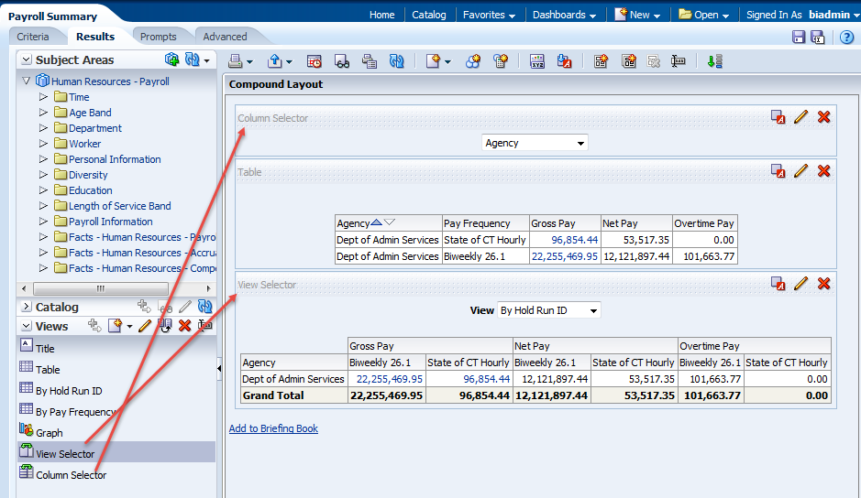
1. Course Introduction
Analysis

Slide 6
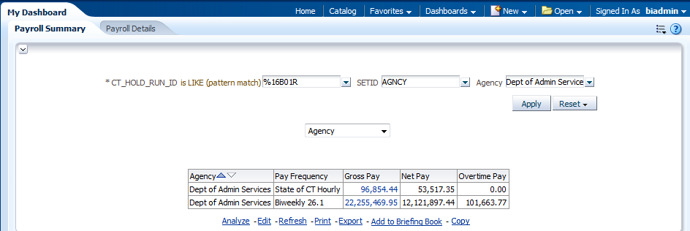
1. Course Introduction
Dashboard

Slide 7
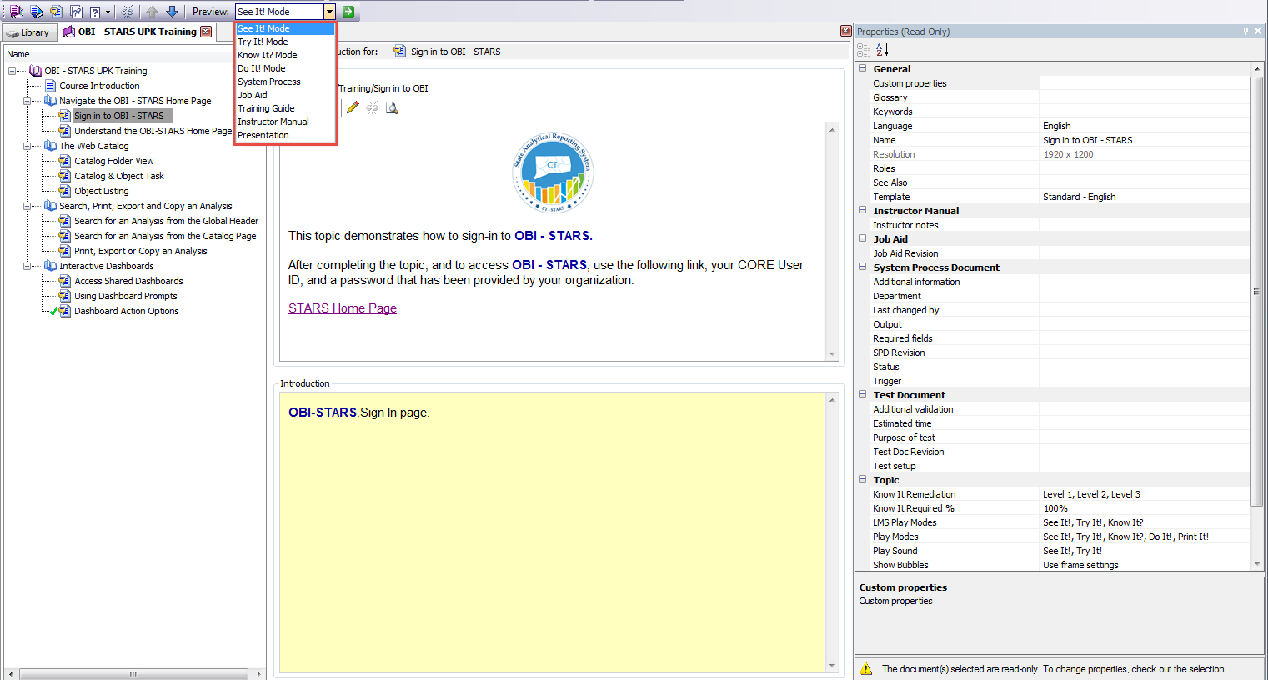
2. UPK/Navigate OBI- STARS
UPK
UPK – User Productivity Kit
Return to ToC

Slide 8
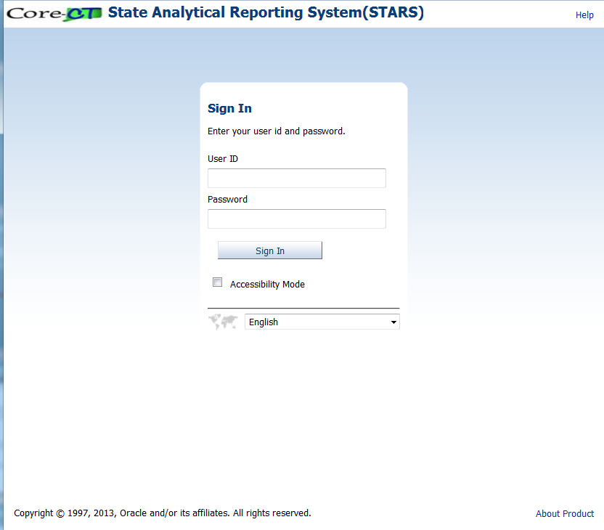
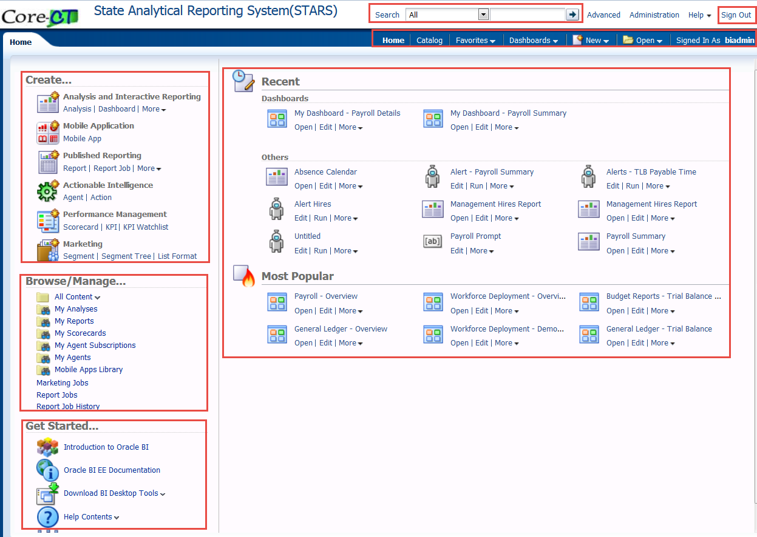
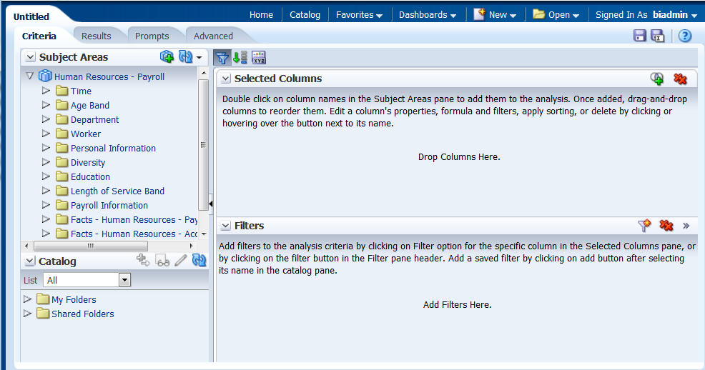
2. UPK/Navigate OBI- STARS
Navigate OBI-STARS
At the end of this section, you will be able to complete the following Objectives:
Sign into OBI – STARS and understand the Homepage
Understand the Analysis Editor Criteria & Results tabs

Slide 9
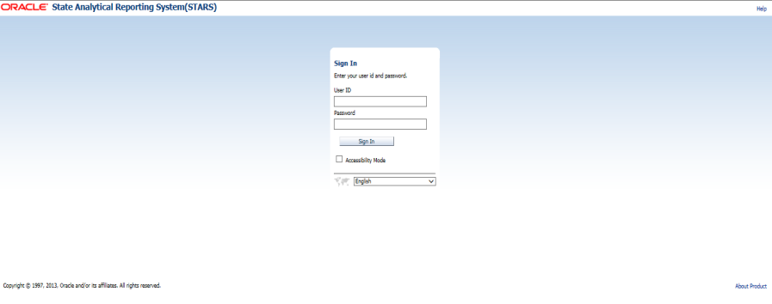
2. UPK/Navigate OBI- STARS
Sign into OBI-STARS
To access the OBI-STARS Production environment, click on the following link or copy and paste it into your browser’s URL section.
https://stars.ct.gov/
Next, type your OBI-STARS user ID and Password, then click sign in.
Note: You should have received your user ID and changed your password when you took the intro to OBI-STARS
training.

Slide 10
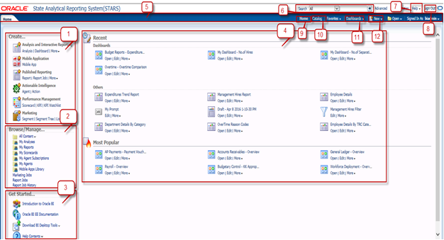
2. UPK/Navigate OBI- STARS
Understand OBI-STARS Home page
The OBI-STARS Home page provides an intuitive, task-based entryway into the functionalities of OBI-STARS. The Home page is divided into sections that allow you to quickly begin specific task, locate, or create a new project, or access technical documentation.
Global Header
Create section
Browse/ Manage section
Get Started section
Recent section
Most Popular section
Notes:
Introduction
The Home page provides an intuitive, task-based entryway into the functionalities of OBI. The Home page is divided into sections that allow you to quickly begin a specific task, locate, or create a new object, or access technical documentation.
Create
The Create section allows you access to editors for OBI objects to create OBI content, including analyses, agents, Key Performance Indicators, and analyses.
Browse/Manage
In the Browse/Manage section, you can search content using the Catalog page by clicking the All Content link or apply default searches that return OBI objects that belong to you using the My Analysis, My Agents, and other similar links.
Get Started
In the Get Started section, you can access download links for OBI desktop tools, for example, the OBI Office Add-In, as well as access technical documentation and other related content.
Recent/Most Popular
The Recent and Most Popular sections contain recently opened objects, and those that are most popular among you and other users of the system.
Global Header
You use this section to access links and options to begin a task or locate an object.
Search
You use this option to search for an object from the global header. You can search for an object by its name, location, or type only, which is similar to using a Find dialog box in many products. You will find only those objects for which you have the appropriate permissions. When the desired object is located, you can click it to display it for viewing or editing, as your permissions allow.
Help button
You use this link to display the following options:
BIEE Home Help dynamically changes to display the Help topic for the current page, editor, or tab.
Help Contents displays a cascading menu that provides options that link to the tables of contents for OBI, BI Publisher, and Marketing.
Documentation displays the documentation library for OBI.
OTN… displays the Business Intelligence and Data Warehousing Technology Center page on the Oracle Technology Network (OTN).
About OBI displays a dialog identifying the OBI version and copyright information.
Sign Out link
You use this link to log out of the OBI application.
Note: Do not close the browser window to exit from OBI.
Home link
You use this link to navigate to the Home page from any other part of the user interface.
Catalog link
You use this link to navigate to the Catalog page, in which you can navigate and work with objects in the Presentation Catalog.
Dashboards link
You use this link to access the customized Dashboards and My Dashboard, used to display analyses created in Analysis Editor.
New link
You use this link to display a list of the objects that you can create. To create an object, select it from the list. The appropriate dialog or editor displays for you to create the object.

Slide 11
2. UPK/Navigate OBI- STARS
Understand OBI-STARS Home page
Instructor Demonstration

Slide 12
2. UPK/Navigate OBI- STARS
Understand OBI-STARS Home page
Student Activity
Exercise Steps
1. If you’re logged into OBI-STARS proceed to step # 4 Open Mozilla Firefox and enter the URLhttps://stars.ct.gov/ in the Address field. Note: The OBI login window displays.
2. Enter your User ID and Password in the appropriate fields
3. Click Sign in Note: The application launches and displays the Analysis Editor Home page
4. Examine all the functionalities in the next slide or refer to the outline in section 2.1 in the user guide

Slide 13
2. UPK/Navigate OBI- STARS
Understand OBI-STARS Home page
Introduction | The Home page provides an intuitive, task-based entryway into the functionalities of OBI. The Home page is divided into sections that allow you to quickly begin a specific task, locate, or create a new object, or access technical documentation.
Create | The Create section allows you access to editors for OBI objects to create OBI content, including analyses, agents, Key Performance Indicators, and analyses.
Browse/Manage | In the Browse/Manage section, you can search content using the Catalog page by clicking the All Content link or apply default searches that return OBI objects that belong to you using the My Analysis, My Agents, and other similar links.
Get Started | In the Get Started section, you can access download links for OBI desktop tools, for example, the OBI Office Add-In, as well as access technical documentation and other related content.
Recent/Most Popular | The Recent and Most Popular sections contain recently opened objects, and those that are most popular among you and other users of the system.
Global Header | You use this section to access links and options to begin a task or locate an object.
Search | You use this option to search for an object from the global header. You can search for an object by its name, location, or type only, which is similar to using a Find dialog box in many products. You will find only those objects for which you have the appropriate permissions. When the desired object is located, you can click it to display it for viewing or editing, as your permissions allow.
Help button | You use this link to display the following options: BIEE Home Help dynamically changes to display the Help topic for the current page, editor, or tab. Help Contents displays a cascading menu that provides options that link to the tables of contents for OBI, BI Publisher, and Marketing. Documentation displays the documentation library for OBI. OTN… displays the Business Intelligence and Data Warehousing Technology Center page on the Oracle Technology Network (OTN). About OBI displays a dialog identifying the OBI version and copyright information.
Sign Out link | You use this link to log out of the OBI application. Note: Do not close the browser window to exit from OBI.
Home link | You use this link to navigate to the Home page from any other part of the user interface.
Catalog link | You use this link to navigate to the Catalog page, in which you can navigate and work with objects in the Presentation Catalog.
Dashboards link | You use this link to access the customized Dashboards and My Dashboard, used to display analyses created in Analysis Editor.
New link | You use this link to display a list of the objects that you can create. To create an object, select it from the list. The appropriate dialog or editor displays for you to create the object.

Slide 14
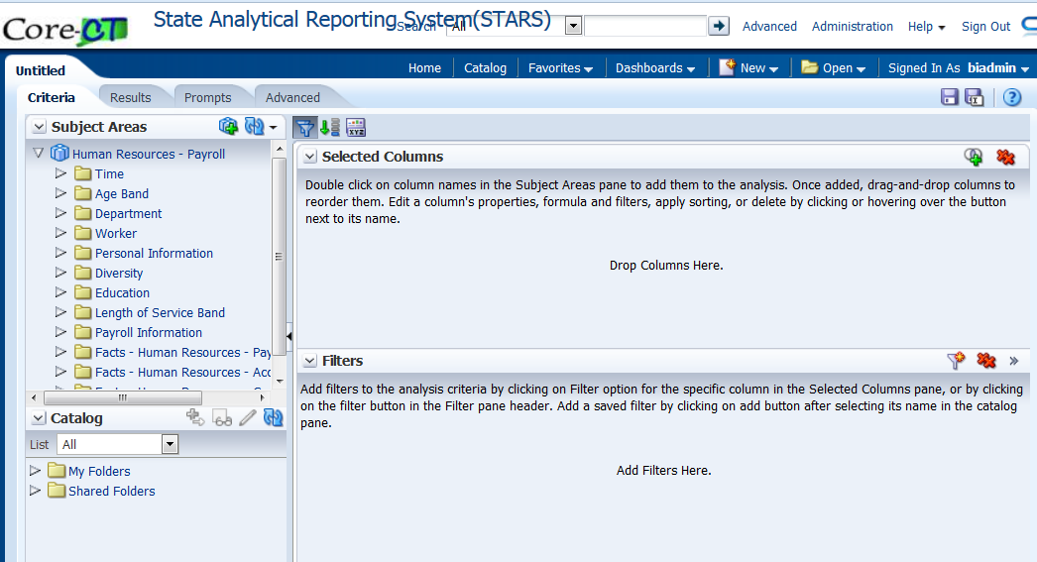
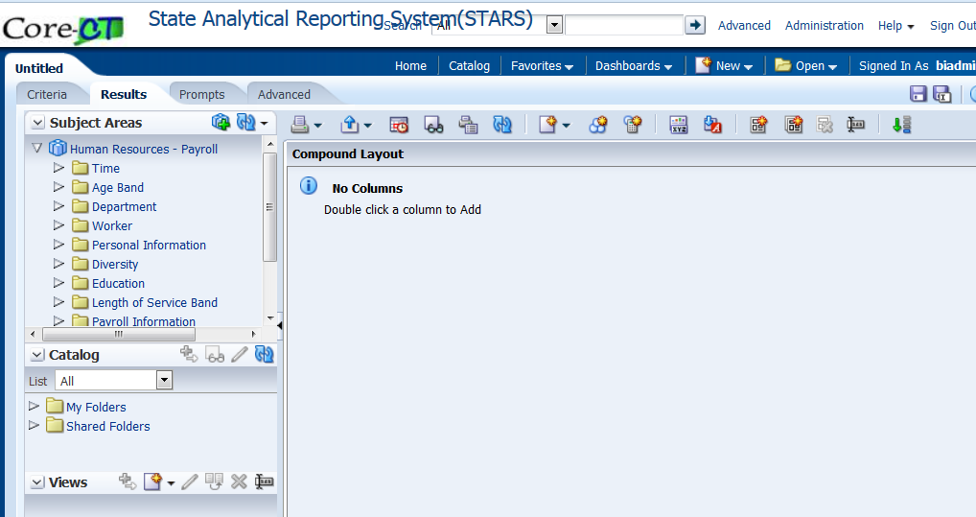
2. UPK/Navigate OBI- STARS
Understand the Analysis Editor Criteria & Results tabs
The Analysis Editor Criteria allows you to drill down into a Subject Area and view the data elements it encompasses. You can view the individual data tables and the respective columns that are associated with each Subject Area.
As use of OBI- STARS expands in your organization, additional Subject Areas may be created that are applicable to your reporting strategy.
Notes:
Criteria
It is used to specify the criteria for an analysis, including columns and filters.
Results
It is used to create different views of the analysis results such as graphs, tickers, and pivot tables.
Prompts
Prompts tab to access the "Prompt editor" to create prompts that allow users to select values that dynamically filter all views within the analysis or all analyses on a dashboard.
Advanced
It is used to examine or edit the XML code and logical SQL statement that is generated for an analysis.
Save
Use this button to save an analysis.
Save As
Use this button to save an analysis as another name.
Common Components:
Subject Areas
In this section we select the columns and hierarchy levels for an analysis and to work with subject areas.
There are three column types in a subject area. They are
Attribute Column
Presentation Columns are renamed as Attribute Columns. In OBI they are also called as Dimension Columns. Example:- Department (as shown in below fig)
Measure Column
It holds a simple list of data of values. It is a column in an OBI repository, usually in a Fact Table. Example Age(Years) (shown in below fig)
Hierarchy Column
Holds a list in which individual members are shown in an outline manner, with lower-level members rolling into higher-level members, and outline totals being shown for the higher-level members. Example: - Not shown here.
Catalog
This section is used to drag and drop objects from the catalog to add to the analysis like saved filters.
General Components:
Selected Columns
In this pane we used to modify the columns and hierarchy levels that have been selected for an analysis.
Filters
It is used to create new filters for an analysis.
Add the Guided Exercise art triangle at the beginning of each exercise
Elements
Description
Print this analysis
You use this button to print in PDF or HTML formats.
Export this analysis
You use this button to export analysis or data in different formats.
Show how results will look on a Dashboard
You use this button to preview the current view.
Print Options
You use this button to specify areas for printing.
Refresh the results of the current analysis
You use this button to refresh the results of the current analysis Deletes the view
Caution: There is no confirmation.
New View
You use this button to display a list of views from which you can select the view that you want to create. The view is added to the current compound layout.
New Group
You use this button to add a group.
New Calculated Item
You use this button to build calculated items.
Edit Analysis Properties
You use this button to specify properties for the entire analysis.
Import formatting from another analysis
You use this button to select an analysis from which to import formatting for columns and views.
Create Compound Layout
You use this button to create a new instance of the compound layout.
Duplicate Compound Layout
You use this button to create a copy of the current compound layout. When you copy, you do not actually create additional copies of the analysis or its views. The analysis and views exist only once. Any changes that you make to the analysis or its views are reflected in the multiple instances of the compound layout.
Delete Compound Layout
You use this button to delete the current compound layout. The views in the layout are not deleted from the analysis. This button is not available if you attempt to delete the last compound layout in the analysis.
Rename the Analysis
You use this to rename the analysis
Show/Hide Selection Steps pane
You use this button to show or hide the display of the Selection Steps pane in the Results tab.
Save Analysis button
You use this button to save an analysis to a folder.
Save As button
You use this button to save an existing analysis as another name.
Help
You use this button to open the first level of help documentation for the Analysis Editor

Slide 15
2. UPK/Navigate OBI- STARS
Understand the Analysis Editor Criteria & Results tabs
Instructor Demo

Slide 16
BREAK

Slide 17
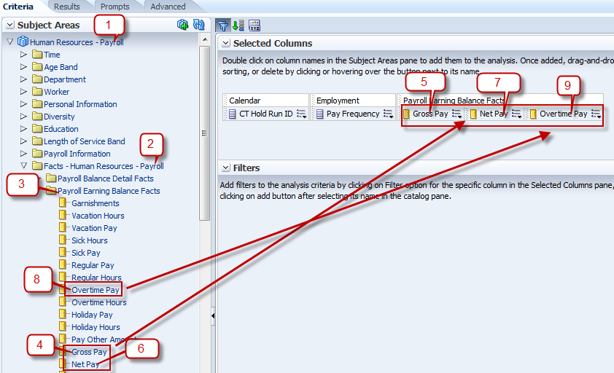
3. Create and Save Analysis
The Analysis Editor interface is part of the State Analytical Reporting System (STARS) application used to query information across all the different agencies within the State of CT system. The Analysis Editor function allows you to explore and interact with information, and present and visualize information using drillable tables, graphs, pivot tables, and other reporting formats. You can save, organize, and share the results through Dashboards, alerts, or exporting to another format.
At the end of this section, you will be
able to complete the following
Objectives:
Create a New Analysis
Save Filters from Analysis
Apply Saved Filters
Notes:
Analyses are user-defined reports that pull data from a consolidated data warehouse. Analyses that you create with the Analysis Editor can be saved in the OBI Presentation Catalog and integrated into a dashboard. Results can be enhanced through graphing, compound layout, calculation, and drilldown features.
Analyses can be tailored and altered to meet the needs of each individual user. Analyses created in the Analysis Editor must be saved in order to use and display on Dashboards. You can save analyses to private folders for quick execution and modification. You can also save analyses to a common shared folder to grant other users access to analyses that you create. In this module, you will learn how to save analyses and modify previously saved analyses.

Slide 18
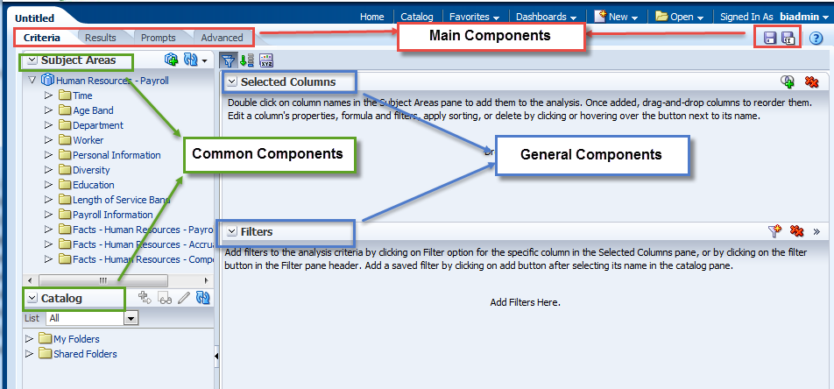
3. Create and Save Analysis
Understand the Analysis Editor View
Notes:
Exercise Steps
Review the following components on Analysis Editor Page.
Main Components:
Criteria
It is used to specify the criteria for an analysis, including columns and filters.
Results
It is used to create different views of the analysis results such as graphs, tickers, and pivot tables.
Prompts
Prompts tab to access the "Prompt editor" to create prompts that allow users to select values that dynamically filter all views within the analysis or all analyses on a dashboard.
Advanced
It is used to examine or edit the XML code and logical SQL statement that is generated for an analysis.
Save
Use this button to save an analysis.
Save As
Use this button to save an analysis as another name.
Common Components:
Subject Areas
In this section we select the columns and hierarchy levels for an analysis and to work with subject areas.
There are three column types in a subject area. They are
Attribute Column
Presentation Columns are renamed as Attribute Columns. In OBI they are also called as Dimension Columns. Example: Department (as shown in below fig)
Measure Column
It holds a simple list of data of values. It is a column in an OBI repository, usually in a Fact Table. Example Age(Years) (shown in below fig)
Hierarchy Column
Holds a list in which individual members are shown in an outline manner, with lower-level members rolling into higher-level members, and outline totals being shown for the higher-level members. Example: - Not shown here.
Catalog
This section is used to drag and drop objects from the catalog to add to the analysis like saved filters.
General Components:
Selected Columns
In this pane we used to modify the columns and hierarchy levels that have been selected for an analysis.
Filters
It is used to create new filters for an analysis.

Slide 19
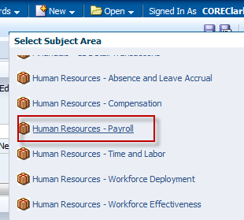
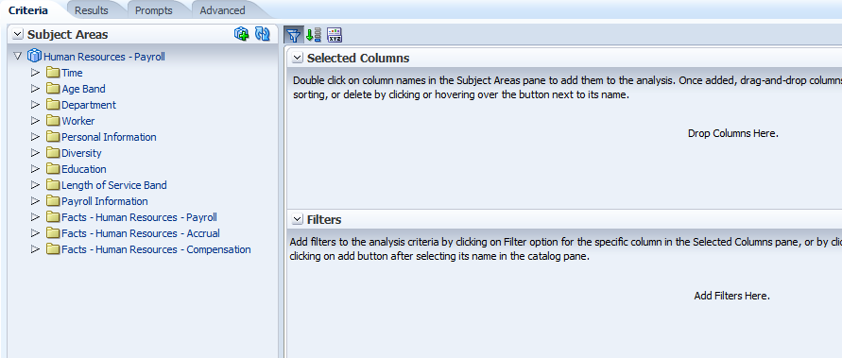
3. Create and Save Analysis
Create a New Analysis
The Analysis Editor interface allows you to:
Make analytical analyses based on data that is stored in the data warehouse.
Select specific tables and columns that are stored within the data warehouse to execute a specific analytical analysis.

Slide 20
3. Create and Save Analysis
Create a New Analysis
Instructor Demo

Slide 21
3. Create and Save Analysis
Create a New Analysis
Student Activity
In this exercise we will be creating Payroll Summary Report so you can view the Payroll amount by different Agencies and Departments.
To do this: Refer to Guided Exercise section 3.1.

Slide 22
3. Create and Save Analysis
Save Filters from Analysis
Users may find it useful to save complicated filters that could apply to many different queries, so that you don’t have to keep recreating them.

Slide 23
3. Create and Save Analysis
Save Filters from Analysis
Instructor Demo

Slide 24
3. Create and Save Analysis
Save Filters from Analysis
Student Activity
In this exercise we will learn how to save Filters which we created in Payroll Summary Report.
To do this: Refer to Guided Exercise section 3.2.

Slide 25
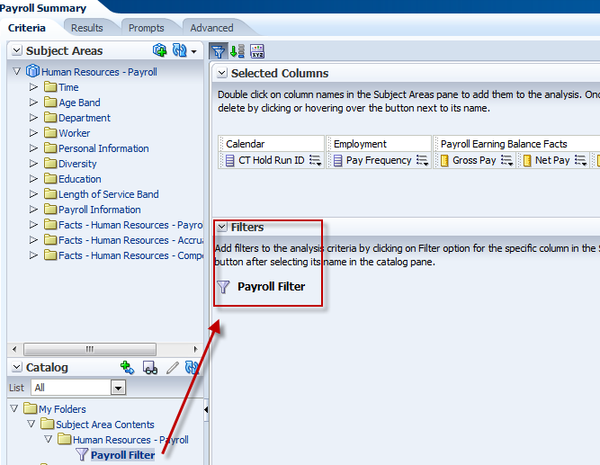
3. Create and Save Analysis
Apply Saved Filters
We can apply saved filters to the analysis if same filter conditions apply.

Slide 26
3. Create and Save Analysis
Apply Saved Filters
Instructor Demo
Notes:
The below are Apply Saved Filter contents:
1. Filter Location : - It will show the path where this filter is saved.
2. Contents of Filter : - It will display all the conditions used in the saved filter.
3. Filter Options : - Clear all existing filters before applying:- It will clear all the filters which are being used in the current analysis and will apply this saved filter.
Apply contents of filter instead of a reference to the filter: - It will display all the condition instead of filter name in the filter pane.

Slide 27
3. Create and Save Analysis
Apply Saved Filters
Student Activity
In this exercise we will apply the saved filter to Payroll Summary Report.
To do this: Refer to Guided Exercise section 3.3.

Slide 28
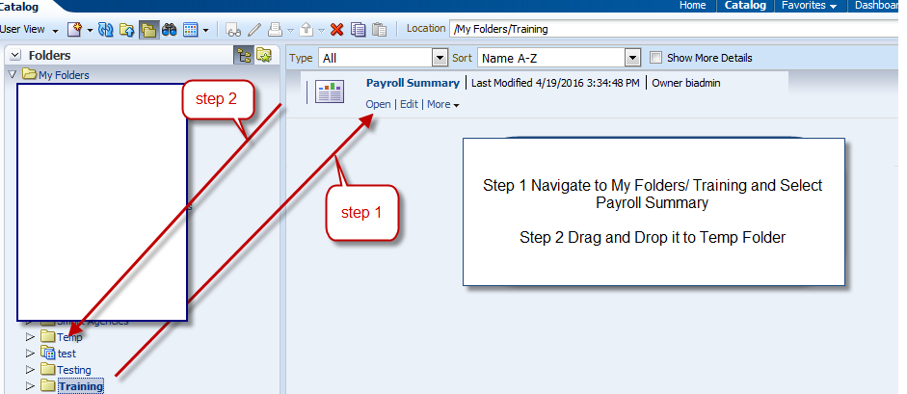
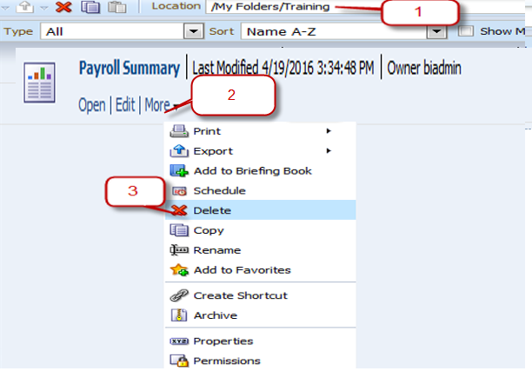
3. Create and Save Analysis
Move or Delete Analysis
An Analysis can be moved from one folder to another folder either by copy and paste or by drag and drop.
Analysis can be deleted from a catalog.
Note: Delete will permanently delete the file from OBI
Notes:
HIDDEN/Excluded Training/Time Crunch

Slide 29
3. Create and Save Analysis
Move or Delete Analysis
Instructor Demo
Notes:
HIDDEN/Excluded Training/Time Crunch

Slide 30
3. Create and Save Analysis
Move or Delete Analysis
Student Activity
In this exercise we will learn how to move and delete an OBI analysis.
To do this: Refer to Guided Exercise section 3.4.
Notes:
HIDDEN/Excluded Training/Time Crunch

Slide 31
4. Format Analysis & Columns
After you run an analysis, the results are formatted using default formatting rules. By adding additional formatting to the results, you can draw focus to blocks of related information and call attention to specific data elements.
You can edit properties for a column to control the appearance and layout of a column and its contents. You can also specify formatting to apply only if the contents of the column meet certain conditions. By default, your selections for a column apply only to the current analysis.

Slide 32
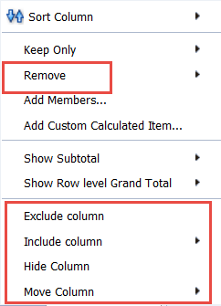
4. Format Analysis & Columns
Move, Add, Exclude, Hide & Delete Columns
In the Compound Layout under Results tab, we have the ability to change the presentation of data based on the desired outcome.
Column order can be changed
New column can be added to existing analysis from View properties.
A column can be excluded, Hide & Delete from the View.

Slide 33
4. Format Analysis & Columns
Move, Add, Exclude, Hide & Delete Columns
Instructor Demo
Move a Column
Add a Column
Exclude, Hide & Delete Column

Slide 34
4. Format Analysis & Columns
Move, Add, Exclude, Hide & Delete Columns
Student Activity
In this exercise we will learn how to Move, Add, Exclude, Hide & Delete Columns.
To do this: Refer to Guided Exercise section 4.1.

Slide 35
4. Format Analysis & Columns
Sort a Column
Column results can be sorted in ascending or descending order for an analysis. You can sort on multiple columns for an analysis. When sorting on multiple columns, the sort order is indicated by a number that displays in the lower left corner of the Order by button.

Slide 36
4. Format Analysis & Columns
Sort a Column
Instructor Demo
Sort a Column

Slide 37
4. Format Analysis & Columns
Sort a Column
Student Activity
In this exercise we will learn how to Sort a Column from Criteria or Results tab.
To do this: Refer to Guided Exercise section 4.2.

Slide 38
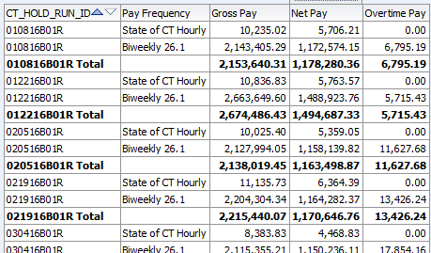
4. Format Analysis & Columns
Add Totals
We can display a sub-total for a numerical column based on specific criteria; this will total a subset of rows and create an additional row for the subtotal.
We can total any number of Attribute columns; we cannot total Fact columns. However, we must have Fact columns in your analysis for the totals to work correctly.
We can also analysis a grand total for a numerical column based on all returned records.

Slide 39
4. Format Analysis & Columns
Add Totals
Instructor Demo
Adding Totals & Sub Totals

Slide 40
4. Format Analysis & Columns
Add Totals
Student Activity
In this exercise we will learn how to add totals and sub-totals.
To do this: Refer to Guided Exercise section 4.3.

Slide 41
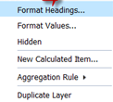
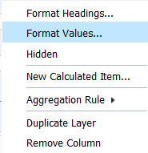
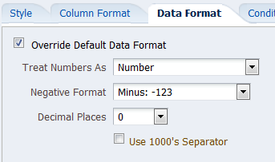
4. Format Analysis & Columns
Edit Column Formats
Formatting rules are applied to the analysis results.
We can create additional formatting to apply to specific results.
Additional formats help you to highlight blocks of related information and call attention to specific data elements.
We can also use additional formatting to customize the general appearance of analyses and dashboards.
We can override the default for alphanumeric data.
This function is often used in conjunction with numerical data, such as percent, currency, to designate the number of decimal digits; or with dates, to designate a different mm/dd/yyyy format and month/day name instead of a number (April instead of 4).

Slide 42
4. Format Analysis & Columns
Edit Column Formats
Instructor Demo
Edit Column Format
Edit Value Format
Edit Data Format

Slide 43
4. Format Analysis & Columns
Edit Column Formats
Student Activity
In this exercise we will learn how to edit column, value & Data format.
To do this: Refer to Guided Exercise sections. 4.4, 4.5 & 4.6

Slide 44
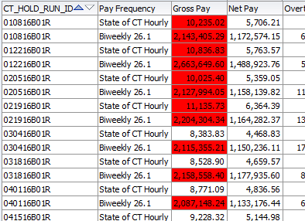
4. Format Analysis & Columns
Apply Conditional Format
Conditional formatting helps direct attention to a data element when the value meets a certain condition.
We can establish conditional formatting within a column by specifying criteria and indicating the use of distinct font, cell, border, and setting options when the condition is met.
Conditional formats include s colors, fonts, images, and so on, for both the data and for the table cell that contains the data.

Slide 45
4. Format Analysis & Columns
Apply Conditional Format
Instructor Demo

Slide 46
4. Format Analysis & Columns
Apply Conditional Format
Student Activity
In this exercise we will learn how to apply conditional formatting on Gross Pay Column in Payroll Summary Report.
To do this: Refer to Guided Exercise section 4.7.

Slide 47
LUNCH

Slide 48
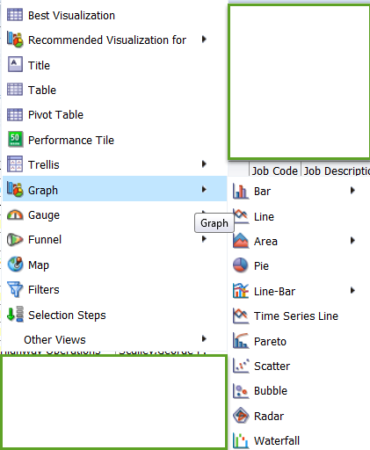
5. Customize Analysis View
Views use the presentation capabilities of OBI to help you look at results of analyses in meaningful, intuitive ways..
You can add a variety of views to the results, such as graphs and pivot tables that allow drilling down to more detailed information, explanatory text, a list of filters that were used to limit the results, and more.
Preparing multiple views of results can help you identify
trends and relationships in data. If you are customizing
results for display on a dashboard, then you can preview
how the combination and position of views will look when
viewed on a dashboard.
We can then save the analysis with the collection of views.

Slide 49
5. Customize Analysis View
Type of Views
It displays the views assembled for display on a dashboard, according the selected compound layout.
When you run a new analysis, the default assemblage of views can include a title view and either a table or pivot table view.
The following are type of views:-
Compound Layout, Title, Table, Pivot Table, Graph, Funnel, Gauge, Map View, Filters, Column Selector, View Selector, Legend, Narrative, Ticker, Static Text, Logical SQL.
Notes:
Compound Layout:- Use this view to display and assemble multiple views.
Note: This is the initial default view until another view type is selected.
Title :- Use this view to add a title, a subtitle, a logo, a link to a custom online help page, and timestamps to the results.
Note: This view is added automatically to analysis results.
Table:- Use this view to show results in a standard table. You can navigate and drill down, add totals, customize headings, and change the formula or aggregation rule for a column. You can also control the appearance of a column and its contents, and specify formatting to apply only if the contents of the column meet certain conditions.
Pivot Table:- Use this view to take row, column and section headings and swap them around to obtain different perspectives. You can drag and drop headings to pivot results, preview them and apply the settings. You can navigate through pivot tables and drill down into information. You can create complex pivot tables that show aggregate and unrelated totals next to the pivoted data, allowing for flexible analysis. For an interactive result set, elements can be placed in pages, allowing you to choose elements.
Graph:- Use this view to modify the graph layout. You can customize the title, legend location, axis titles, data labels, the size, and scale of the graph, and control colors using a style sheet.
The Analysis Editor supports a variety of standard graph types, including bar graphs, column graphs, line graphs, area graphs, pie graphs, and scatter graphs.
Funnel:- Use this view to show a three-dimensional graph that represents target and actual values using volume, level, and color. It is useful for depicting target values that decline over time, such as a sales pipeline.
Gauge :- Use this view to display a standard “gauge” graphic to indicate where a measure falls within a specific range. You can choose from several gauge graphics, color scheme size and measure highs and lows.
Map view :- Use this view to present business data to users. As with views such as tables, pivot tables, and graphs, map views allow users to display data on maps in a number of different formats and to interact with the data. When data is visualized on a map, relationships among data values that might not have been obvious previously can be displayed in a much more intuitive manner. For example, a map view can show a map of a city with the zip codes color-coded by sales performance, while an image marker displays the average discount given per order.
Filters :- Use this view to show the filters in effect for an analysis. Filters allow you to constrain an analysis to obtain results that answer a particular question.
Column Selector :- Use this view to change dynamically which columns display in results. This allows you to analyze data along several attributes. By changing the facts, you can dynamically alter the content of the results.
View Selector :- Use this view to change the view dynamically by which analysis results are displayed. Multiple views must be created in order for the View Selector view to be enabled.
Legend :- Use this view to display specific captions or text for a table axis. You can adjust the font and location of the legend within the view.
Narrative :- Use this view to display the results as one or more paragraphs of text. You can type in a sentence with placeholders for each column in the results, and specify how rows should be separated.
Ticker :- Use this view to display the results as a ticker or marquee, similar in style to the stock tickers that run across many financial and news sites on the Internet. You can control what information is presented and how it scrolls across the page.
Static Text :- Use this view to include static text in the results. You can use HTML to add banners, tickers, ActiveX objects, Java applets, links, instructions, descriptions, graphics, and so on, in the results.
Logical SQL :- Use this view to show the SQL generated for the analysis. This view is useful for trainers and administrators, and is usually not included in results for typical users. You cannot modify this view, except to delete it.

Slide 50
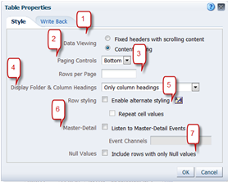
5. Customize Analysis View
Table Properties
We can modify the following view properties in the results tab.
Data Viewing
Paging Controls
Rows per Page
Display Folder & Column Headings
Row Styling
Master – Detail
Null Values
Notes:
Data Viewing:-
Fixed headers with scrolling content:- This will allow us to enter Maximum width and height sizes. By enabling this it will disable option 2 and 3.
Content Paging:- This is the arrow marks which can be viewed at the end of table. . It will by default gives 100 rows per page.
Single arrow will only display only the next 100.
Double arrow will display all the rows.
Paging Controls:- It will give you the option of where to display the Content Paging on the page.
Rows per Page:- By entering a value in the box it will display only those no.of rows. By default it will display 100 rows per page.
Display Folders & Column Headings:-Choose the value from the drop-down menu to select, so that based on that the Folders and column headings will displayed.
Row Styling :- It will allow us to change the color or format or other formats.
Master – Detail:-Use this box to specify whether a table or pivot table is to act as a detail view in a master-detail relationship and listen for master-detail events. Select this box and then specify the channel or channels in the Event Channels field.
Null Values:- It will include rows with only Null Values.

Slide 51
5. Customize Analysis View
Table Properties
Instructor Demo

Slide 52
5. Customize Analysis View
Table Properties
Student Activity
In this exercise we will learn the navigation on how to go to Table Properties.
To do this: Refer to Guided Exercise section 5.2.

Slide 53
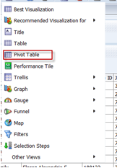
5. Customize Analysis View
Add & Customize a Pivot Table
A pivot table is a table that we can use to summarize large amounts of data quickly. We can rotate rows and columns to see different summaries of the source data, as well as add column and row grand totals.
The pivot table view is an interactive view that allows you to rotate the rows, columns, and section headings to obtain different perspectives of the data.
Pivot tables are navigable and drillable, and are especially useful for trending and comparative analyses.

Slide 54
5. Customize Analysis View
Add & Customize a Pivot Table
Instructor Demo

Slide 55
5. Customize Analysis View
Add & Customize a Pivot Table
Student Activity
In this exercise we will create pivot table on Payroll Summary based on CT_HOLD_RUN_ID and Pay Frequency.
And also we will learn how to add a graph beside Pivot table.
To do this: Refer to Guided Exercise sections 5.3 & 5.7.

Slide 56
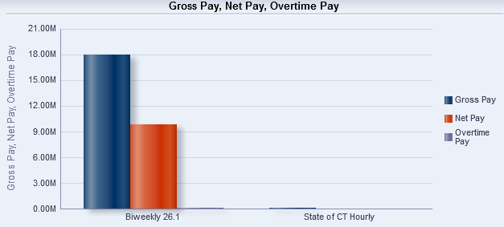
5. Customize Analysis View
Add & Format a Graph
Graphs display a graphical representation of the extracted data. You can add a graph view to analysis results, or you can replace the table with a graph.
The default graph for an analysis is a two-dimensional vertical bar graph, drawn using the attributes and measures that are selected first within the analysis. You can select additional columns to display within a graph based on what is available in the Columns section of the Add/Edit Graph view.
We can also change the formatting, displayed text, legend, style, and size of a graph, which adjusts the landscape of a dashboard page.
Notes:
Bar:-Shows quantities associated with categories. Bar graphs show quantities as bar lengths and categories as bars or groups of bars.
Bar graphs are useful for comparing differences among like items; for example, competing product sales, same product sales over different time periods, or same product sales over different markets.
Can be used to compare measure columns by showing bars in a horizontal or vertical direction.
Line:-Shows quantities over time or by category.
Line graphs are useful for showing trends over time.
Can be used to plot multiple measure columns.
Area
Shows the trend of the contribution of each value over time or by category.
It is a line graph for which the regions between lines are filled in. Regions stack, adding up to the total value for each time period or category.
Pie
Shows data sets as percentages of a whole.
Pie graphs are useful for comparing parts of a whole, such as sales by region or by district.
Line-Bar
Plots two sets of data with different ranges, one set as bars, and one set as lines overlaid on the bars.
Line bar graphs are useful for showing trend relationships between data sets.
Time Series Line
Plots time series data. It scales the horizontal axis based on the time that has elapsed between data points.
Pareto
Is a form of bar graph and line graph that displays criteria in descending order. In this graph type, the line shows a cumulative total of the percentages.
Pareto graphs are useful for identifying significant elements, such as best and worst or most and least.
Scatter
Displays x-y values as discrete points, scattered within an x-y grid. It plots data points based on two independent variables. This enables you to plot large numbers of data points and observe the clustering of data points.
Scatter graphs are useful for observing relationships and trends in large data sets.
Bubble
Is a variation of a scatter graph that displays data elements as circles (bubbles). It shows three variables in two dimensions. One value is represented by the location of the circle on the horizontal axis. Another value is represented by the location of the circle on the vertical axis. The third value is represented by the radius of the circle.
Bubble graphs are useful for plotting data with three variables, and for displaying financial data over a period of time.
Radar
Plots the same information as a bar graph, but instead displays data radiating from the center of the graph. Each data element has its own value axis.
Radar graphs are useful for examining overlap and distribution.

Slide 57
5. Customize Analysis View
Add & Format a Graph
Instructor Demo

Slide 58
5. Customize Analysis View
Add & Format a Graph
Student Activity
In this exercise we will create vertical bar graph based on Payroll Summary Report.
To do this: Refer to Guided Exercise sections 5.4, 5.5 & 5.6.

Slide 59
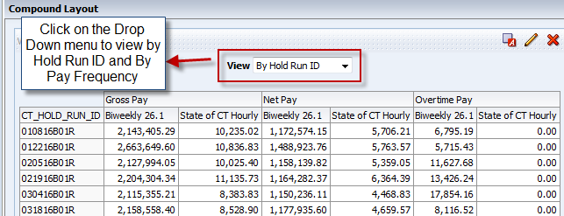
5. Customize Analysis View
View Selector
A view selector view allows users to select a specific view of the results from among the saved views for an analysis. When placed on a dashboard, the view selector is displayed as a list from which users can choose the view that they want to display below the selector.
Generally, you would include views in the view selector
that are not being displayed in the Compound Layout
view.
For example, you might create a table, graph, gauge,
and view selector view for an analysis, but include only
the table and view selector view on the Compound
Layout view. When the analysis is displayed on a
dashboard page, users can select the graph or gauge
view from the view selector view.
Notes:
HIDDEN/Excluded Training/Time Crunch

Slide 60
5. Customize Analysis View
View Selector
Instructor Demo
Notes:
HIDDEN/Excluded Training/Time Crunch

Slide 61
5. Customize Analysis View
View Selector
Student Activity
In this exercise we will create view selector and add multiple views.
To do this: Refer to Guided Exercise section 5.8.
Notes:
HIDDEN/Excluded Training/Time Crunch

Slide 62
5. Customize Analysis View
Column Selector
The Column Selector view allows you to change dynamically which columns display in an analysis. One column selector can be attached to each column in a specific analysis, and multiple columns (attributes) can be attached to each column selector.
Selecting a column enables you to analyze data along several attributes and/or metrics. It also enables you to configure the column order within a dashboard to display data in a clearer layout.
Notes:
HIDDEN/Excluded Training/Time Crunch

Slide 63
5. Customize Analysis View
Column Selector
Instructor Demo
Notes:
HIDDEN/Excluded Training/Time Crunch

Slide 64
5. Customize Analysis View
Column Selector
Student Activity
In this exercise we will create Column Selector on CT_HOLD_RUN_ID with Agency and Job Description.
To do this: Refer to Guided Exercise section 5.9
Notes:
HIDDEN/Excluded Training/Time Crunch

Slide 65
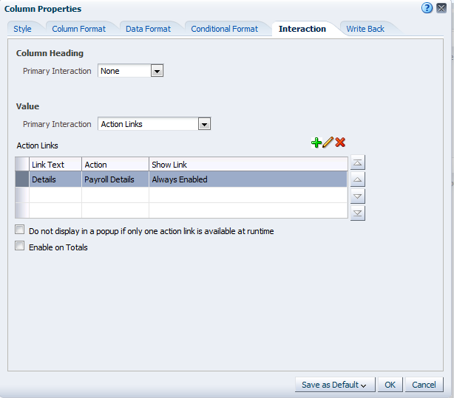
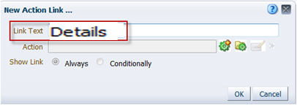
6. Drill Down Functionality
This Functionality shows you how to build and use actions to provide
guided navigation, link to external web content, and invoke web services.
Notes:
Action Links
In the Action Links list, you can view, add, edit, and delete actions associated with the column. Notice that you can have multiple action links associated with a column. By default, actions available for a column appear in a popup when a user clicks the column value or heading in an analysis.
Do not display in a popup if only one action is available at runtime
This option is used to reset, so that in the event only one action is available for a value or heading, the action is executed upon the user interaction. Leave this option unchecked
Enable on Totals
This option is used to enable action links for Grand Totals and Sub Total level.
Add Action Link
To add Action Link
Edit Action Link
Used to edit an existing analysis.
Delete Action Link
Delete an existing analysis
Link Text
Enter some text in the “Link text”, this will popup whenever the user clicks on the column value
Action
Choose the type of action link. In this exercise we will choose “Navigate to BI Content” as we are going to navigate to a page within our dashboards.
Show Link
It is used to apply conditions based on which the action link needs to apply
Add Action Link
Choose the type of action link. In this example we will choose “Navigate to a BI Content” as we are going to navigate to another analysis.
Select existing Action
Choose an action link which has been already created and saved in the folder.
More
This option is used to edit or remove or save action link as.

Slide 66
6. Drill Down Functionality
Instructor Demo
Work with an Existing Analysis
Create Action Link
Test Action Link
Notes:
Work with an Existing Analysis:-
Already an Pre-Built analysis have been created to save time for training purpose.
Create Action Link:-
An action link is a link to an action that you have embedded in an analysis, dashboard page, scorecard objective, scorecard initiative, or KPI that, when clicked, runs an associated action.

Slide 67
6. Drill Down Functionality
Student Activity
In this exercise we will create an action link to a Pre-Built analysis and then will test the link.
To do this: Refer to Guided Exercise sections 6.1, 6.2 & 6.3.

Slide 68
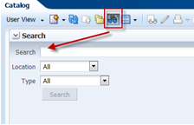
7. Search, Print and Export Analysis
Search an Analysis
We can search for objects in the Oracle BI Presentation Catalog.
The basic catalog search allows you to search for an object from the Global Header, Home page, or Catalog page.
We can search for an object by its name, location, or type only, which is similar to using a Find dialog box in many products.
We will find only those objects for which you have the appropriate permissions. When the desired object is located, you can click it to display it for viewing or editing, as your permissions allow.
Notes:
Search
Enter the name of the Analysis, Dashboard, Prompts and so on.
Location
Choose in which folder you want to search.
Type
Select the type of the Search you’re looking for.

Slide 69
7. Search, Print and Export Analysis
Search an Analysis
Instructor Demo

Slide 70
7. Search, Print and Export Analysis
Search an Analysis
Student Activity
In this exercise we will learn on how to search an Analysis from Catalog search pane.
To do this: Refer to Guided Exercise section 7.1.

Slide 71
7. Search, Print and Export Analysis
Print Results to PDF
We can print analysis results to HTML and PDF formats.
By Printing an analysis, we will have the ability to print as well as send an analysis to an individual.

Slide 72
7. Search, Print and Export Analysis
Print Results to PDF
Instructor Demo

Slide 73
7. Search, Print and Export Analysis
Print Results to PDF
Student Activity
In this exercise we will learn on how to print an analysis results to PDF or HTML.
To do this: Refer to Guided Exercise section 7.2.

Slide 74
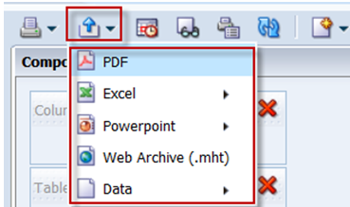
7. Search, Print and Export Analysis
Export Results to Excel
We can export a complete list of analysis results to the following formats:
· Download to Excel 2003 +exports the data in and the formatting as it displays in the view, including graphs, filters, etc.…
· The Download Web Archive is an HTML page and not modifiable.
· Download Data exports just rows of data without formatting.
· Download to PowerPoint exports to PowerPoint
By exporting to Microsoft Excel©, we can save, print, email or manipulate the data in a spreadsheet.

Slide 75
7. Search, Print and Export Analysis
Export Results to Excel
Instructor Demo

Slide 76
7. Search, Print and Export Analysis
Export Results to Excel
Student Activity
In this exercise we will learn on how to export an analysis results.
To do this: Refer to Guided Exercise section 7.3.

Slide 77
break

Slide 78
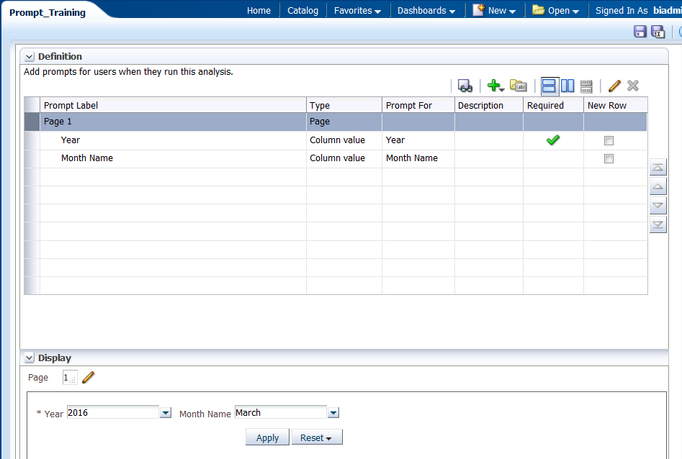
8. Work with Dashboard Prompt
A Dashboard Prompt is interactive and will always appear on the dashboard page so that the user can prompt for different values without having to rerun the dashboard.
A Dashboard Prompt can also interact with selection steps. You can specify a dashboard prompt to override a specific selection step.
The step will be processed against the dashboard column with the user-specified data values collected by the dashboard column prompt, whereas all other steps will be processed as originally specified.
It can filter one or any number of analyses embedded on the same dashboard page

Slide 79
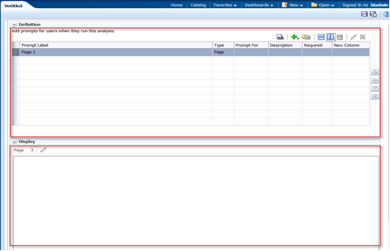
8. Work with Dashboard Prompt
The Dashboard Prompt editor consists of two sections:-
The Definition pane allows you to add, organize, and manage a named prompt's columns. You can use column prompts, image prompts (maps), currency prompts, and variable prompts. The Definition table lets you view high-level information about the prompt's columns. You can also use this table to select columns for editing or deleting, arrange the order in which the prompts appear to the user, or insert row or column breaks between prompt items.
The Display pane is a preview pane that allows you to view the prompt's layout and design.

Slide 80
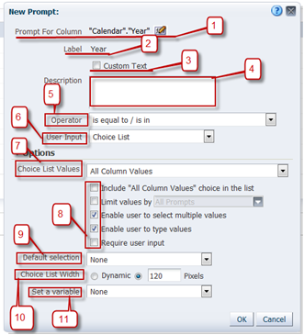
8. Work with Dashboard Prompt
Instructor Demo
Notes:
Elements/Description
New:- Used to add a new Column prompt, Variable prompt or Image prompt
Column / Row based layout:-This is used to select the type of layout you want on the prompts page either Column or Row based.
Edit:- Edit Prompt
Delete:- Delete Prompt
Elements/Description
Prompt for Column:- It shows the column name of the prompt
Label:- It is label which will be displayed
Custom Text:- Enable this to change the default Label
Description:-We can add description for this column
Operator:-Choose appropriate operator
User Input:-The User Input field's drop-down list appears for column and variable prompts and provides you with the option to determine the User Input method for the user interface—in other words, the user will see one of the following: check boxes, radio buttons, a choice list, or a list box. . Use this item in conjunction with the Choice List Values item to specify which data values appear for selection.
Choice List Values:-The Options section provides you with the opportunity to constrain values available for selection.
The series of checkboxes allow you to restrict the amount of data returned. Select Enable user to select multiple values, and Require user input. Allowing multiple selection of values lets you choose more than one value (region for example), and requiring input forces you to enter at least one value.
Default Selection:-It allows you to selection an initial value
Choice List Width:-You the change the width of the Choice List by enabling dynamic or fixing it.
Set a variable:-It allows you to create a new variable that this column prompt will populate

Slide 81
8. Work with Dashboard Prompt
Student Activity
In this exercise we will learn on how to create a Dashboard prompt for Payroll Summary.
To do this: Refer to Guided Exercise sections 8.2.

Slide 82
9. Build and Design a Dashboard
Dashboards provide personalized views of corporate and external information. Based on your permissions, you can view pre-configured dashboards or create your own personalized views.
The ability to create and edit dashboards is controlled by the Manage Dashboard privilege, which is managed by the administrator.
We can view your personalized
views by selecting My Dashboard
from the Dashboards drop-down
list.
We can also set My Dashboard as
your default dashboard.

Slide 83
9. Build and Design a Dashboard
Understand & Navigate My Dashboard
Dashboards consist of multiple pages, which display as tabs across the top of the dashboard screen. Additionally, Analysis Editor
Users have a personal dashboard, called My Dashboard, which enables you to personalize content to meet your requirements.
Dashboard objects are items that are used only in a dashboard. Examples of dashboard objects are sections to hold content, navigation links, and embedded content appearing within a frame in a dashboard.
The look of a dashboard, such as background colors and the size of text, is controlled by styles and skins.
Notes:
Understand Dashboard
Dashboards consist of multiple pages, which display as tabs across the top of the dashboard screen. Additionally, Analysis Editor Users have a personal dashboard, called My Dashboard, which enables you to personalize content to meet your requirements.
Pages can display anything that you can access or open with your Web browser, such as saved OBI analyses, images, graphs, tables, text, and links to Web sites and documents.
Dashboard objects are items that are used only in a dashboard. Examples of dashboard objects are sections to hold content, navigation links, and embedded content appearing within a frame in a dashboard.
You can add content to your personal dashboard by clicking and dragging it from the Dashboard Objects section onto the dashboard layout page, which consists of columns used to align content, and sections used to hold content. The look of a dashboard, such as background colors and the size of text, is controlled by styles and skins. You can modify individual objects on the dashboard to change the overall page appearance.
When you open a dashboard, including My Dashboard, the content appears in one or more dashboard tabs. Pages contain the columns and sections that hold the content of a dashboard, and every dashboard has at least one page. Multiple pages are used to organize content.
This example shows an empty My Dashboard page with no content. Hover over the Edit icon to edit the dashboard and add content.

Slide 84
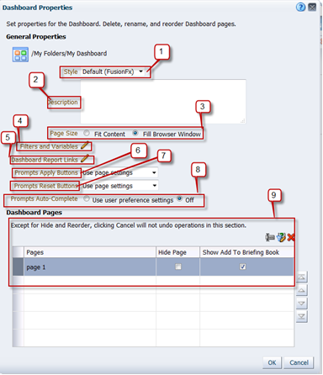
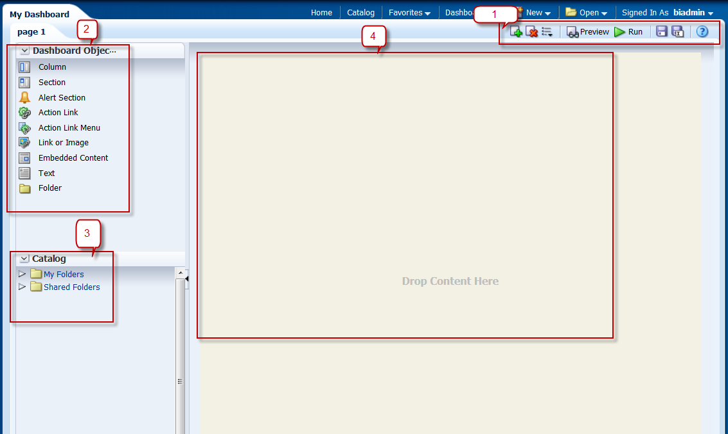
9. Build and Design a Dashboard
Understand & Navigate My Dashboard
Instructor Demo
Notes:
Sections/Description
Dashboard Toolbar
The toolbar allows you to perform tasks such as adding or deleting pages, previewing, saving, and so on.
Dashboard Objects pane
Items that are used only in a dashboard. Examples of dashboard objects are sections to hold content, action links, and embedded content that is displayed in a frame on a dashboard
Catalog pane
Items that you or someone else has saved to the Catalog, for example, analyses, prompts, and so on. In a dashboard, the results of an analysis can be shown in various views, such as a table, graph, and gauge. (The results of an analysis are the output that is returned from the OBI Server that matches the analysis criteria.) Users can examine and analyze results, save or print them, or download them to a spreadsheet.
Page Layout pane
This is a workspace that holds your objects, which are displayed on the dashboard.
Dashboard Properties: -
Elements/Description
Style:- Styles control how dashboards and results are formatted for display, such as the color of text and links, the font and size of text, the borders in tables, the colors and attributes of graphs, and so on
Description: - Descriptions are displayed when OBI Administrators use the Catalog Manager
Page Size: - Use these options to specify how a dashboard page is to be sized
Fit Content — This option sizes the container to the content with no wrapping. If the browser window is smaller than needed to fit the content, a scroll bar is displayed.
Fill Browser Window - Sizes dashboard columns to the largest section in each column
Expands columns (except columns for which a specific absolute size has been specified) and sections proportionally to fill the browser window, if there is any additional horizontal space in the browser window.
Aligns content within columns and sections in the center, by default
Filters and Variables:- To define default filters and variables, embed dashboard prompts with default values. These prompts will not be shown on the dashboard.
Dashboard Report Links:-The report links at the dashboard level. Report links can be set at the dashboard, dashboard page (click Page Options> Page Report Links), or analysis level (click the properties icon for the specific analysis within the Dashboard Builder and then select Report Links).
Prompt Apply Buttons: - Use this list to specify if you want to include or exclude the prompt's Apply buttons on the dashboard at runtime
Use page setting — Select this option to use the Apply buttons as defined by the dashboard page settings
Show All Apply buttons — Select this option to override the dashboard page setting's Apply button preferences and show the Apply buttons for the prompts included on the dashboard and embedded analyses
Hide All Apply buttons — Select this option to override the dashboard page setting's Apply button preferences and hide the Apply buttons for the prompts included on the dashboard and embedded analyses.
Prompts Reset Buttons : -Use this list to specify whether you want to include or exclude the prompt's Reset buttons on the dashboard at runtime
Use page setting —Select this option to use the Reset buttons as defined on the dashboard page settings
Show All Reset buttons — Select this option to override the dashboard page setting's Reset button preferences and show the Reset buttons for the prompts included on the dashboard and embedded analyses.
Hide All Reset buttons — Select this option to override the dashboard page setting's Reset button preferences and hide the Reset buttons for the prompts included on the dashboard and embedded analyses.
Prompts Auto Complete :- Use this option to enable or disable the auto-complete functionality for the dashboard. When enabled, OBI suggests and highlights matching prompt values as the user types in the dashboard's prompt selection field, and highlights matching prompt values in the "Select Values dialog"
Dashboard Pages : -
Displays the pages in the dashboard. Use this area to perform operations (such as hide or rename) on dashboard pages using the dashboard pages toolbar buttons.
Dashboard Page toolbar: - This toolbar contains the following buttons:
Rename — Use this button to display the "Rename dialog", where you specify a new name for the page in the dashboard.
Select a prompt to capture default filters and variables — Use this button to display the "Filters and Variables – page dialog", which enables you to add hidden named prompts to the dashboard page.
Permissions — Use this button to display the "Permission dialog", where you specify which accounts have which levels of access to the contents of the dashboard page. The Permissions button is displayed for shared dashboards only, and only if your user ID is authorized to access the security features.
Delete — Use this button to delete the page from the dashboard. After you click the button, you see a page that prompts you to confirm the deletion.
Specify Who Can Save Shared Customizations — Use this button to display the Permission dialog, where you specify which accounts can save shared customizations for the page.
Specify Who Can Assign Default Customizations — Use this button to display the Permission dialog, where you specify which accounts can assign default customizations for the page.

Slide 85
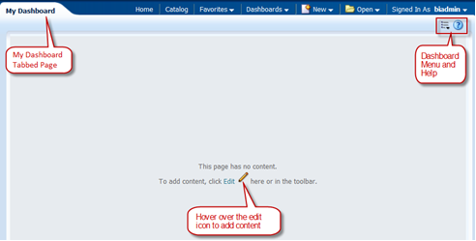
9. Build and Design a Dashboard
Build & Edit My Dashboard
Building My Dashboard

Slide 86
9. Build and Design a Dashboard
Build & Edit My Dashboard
Edit My Dashboard
We can Rename the Dashboard page, add multiple pages.
We can add Report Links to the
Dashboard page so that we can
print, export, edit or refresh
analysis on Dashboard.
We can change the background
color of the section.

Slide 87
9. Build and Design a Dashboard
Build & Edit My Dashboard
Instructor Demo

Slide 88
9. Build and Design a Dashboard
Build & Edit My Dashboard
Student Activity
In this exercise we will learn on how to build My Dashboard using Dashboard Prompt and Payroll Details report.
We will also learn on how to create a new page on My Dashboard and add report links to the dashboard.
To do this: Refer to Guided Exercise sections 9.2 & 9.3

Slide 89
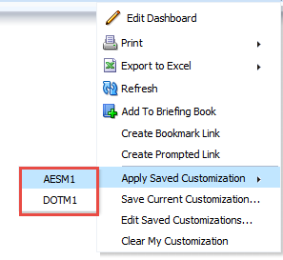
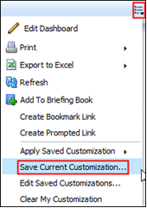
9. Build and Design a Dashboard
Save a Customized Dashboard
Create a personal, customized view of your dashboard page.
Saved customizations allow you to save and view dashboard pages in their current state with your most frequently used or favorite choices for items such as filters, prompts, column sorts, drills in analyses, and section expansion and collapse.
By saving customizations, you do not need to make these choices manually each time that you access the dashboard page.

Slide 90
9. Build and Design a Dashboard
Save a Customized Dashboard
Instructor Demo

Slide 91
9. Build and Design a Dashboard
Save a Customized Dashboard
Student Activity
In this exercise we will learn on how to create a Customized Dashboard from an existing Dashboard.
To do this: Refer to Guided Exercise section 9.4.

Slide 92
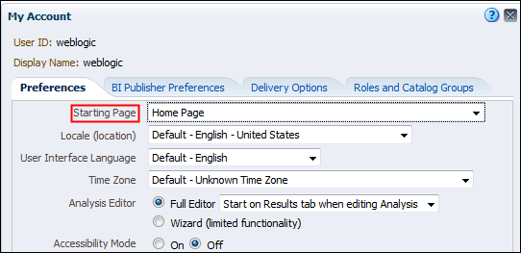
9. Build and Design a Dashboard
Set Preference
Create a personal, customized view of your dashboard page. Saved customizations allow you to save and view dashboard pages in their current state with your most frequently used or favorite choices for items such as filters, prompts, column sorts, drills in analyses, and section expansion and collapse. By saving customizations, you do not need to make these choices manually each time that you access the dashboard page.

Slide 93
9. Build and Design a Dashboard
Set Preference
Instructor Demo

Slide 94
9. Build and Design a Dashboard
Set Preference
Student Activity
In this exercise we will learn on how to set preference by making My Dashboard as Starting Page.
To do this: Refer to Guided Exercise section 9.5.

Slide 95
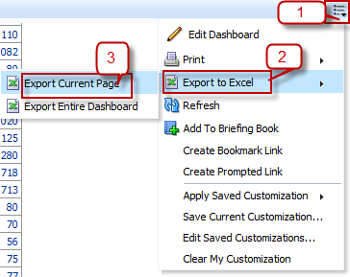
9. Build and Design a Dashboard
Export My Dashboard to Excel Spreadsheet
You can export an entire dashboard or a single dashboard page to Microsoft Excel.
Note: - If there are more than 100 rows then scroll down to the analysis and click on double sided arrow, so that it displays all the rows and now we can export the analysis.

Slide 96
9. Build and Design a Dashboard
Export My Dashboard to Excel Spreadsheet
Instructor Demo

Slide 97
9. Build and Design a Dashboard
Export My Dashboard to Excel Spreadsheet
Student Activity
In this exercise we will learn on how to export Current Page or Entire Dashboard.
To do this: Refer to Guided Exercise section 9.6.

Slide 98
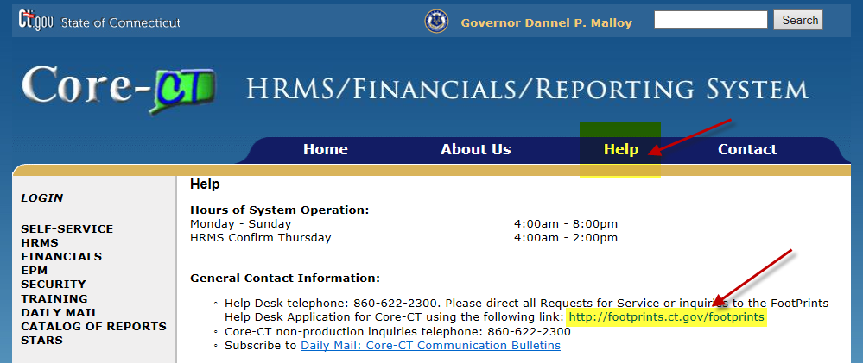
CT- Stars State Analytical Reporting System
Footprints: Support Tickets can be opened via Footprints which is available on Core-CT Home page (http://www.core-ct.state.ct.us) under Help section . You will need to use your desktop login credentials to access Footprints:
98

Slide 99
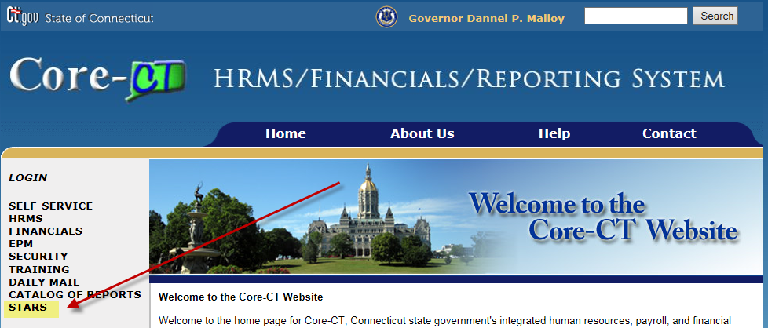
CT- Stars State Analytical Reporting System
Job-aid: All job-aids related to STARS are available on Core-CT Home page (http://www.core-ct.state.ct.us) under STARS :
99

