Slide 1
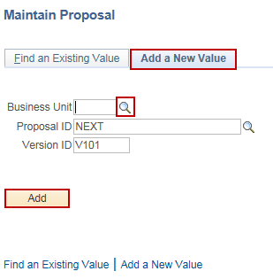
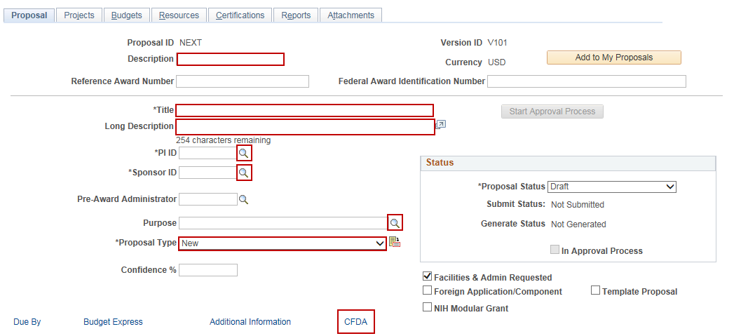
Create a Grant Proposal
Purpose:
This job aid will help you create a Grant Proposal in Core-CT.
Steps | Screenshots
Navigate to the Maintain Proposal page: Main Menu > Core-CT Financials > Grants > Proposals > Maintain Proposal
Select the Add a New Value tab. Use the lookup icon to select a valid Business Unit. Click the Add button.
Enter a description in the Description field (20 char. max). Enter a proposal title in the Title field. Enter a long description in the Long Description field (254 char. max). Click on the PI ID lookup and select a valid value. Click on the Sponsor ID lookup and select a valid value. Click on the Purpose lookup and select a valid value. Select a valid Proposal Type from the dropdown menu. Click on the CFDA hyperlink.

Slide 2
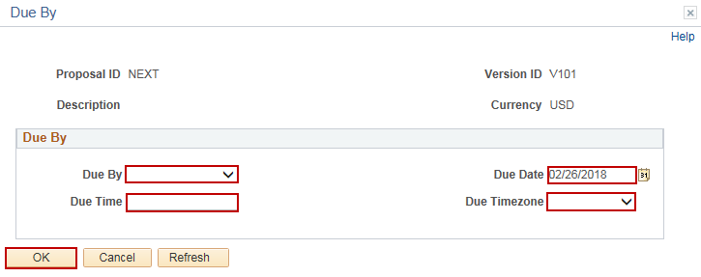
Create a Grant Proposal
Steps | Screenshots
Click on the lookup to select a valid CFDA number. Click the checkbox for Primary. Click on the Return to Maintain Proposal hyperlink.
Enter a Start Date and End Date or use the Calendar icons to select dates. Enter the number of budget periods in the No. Periods field. Click the Build Periods button. Click the Due By hyperlink.
Enter the Due By, Due Date, Due Time and Due Timezone to inform Approvers when the proposal is due. Click the OK button.

Slide 3
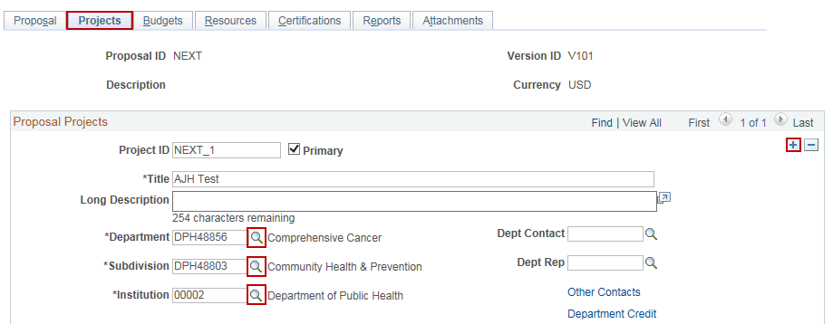
Create a Grant Proposal
Steps | Screenshots
Click on the Projects tab. The Department, Institution and Subdivision fields default based on the PI selection. Click on the lookup icons to select a different Department, Institution and Subdivision, if necessary. To add additional projects, click on the “+” button to add additional projects.
In the F & A Distribution section, the Department field defaults based on the PI selection. Click on the lookup icons to select a different Department for Facilities and Administration Distribution, if necessary. If multiple departments will share the F&A Distribution, click on the “+” button and use the lookup icon to select another Department. Update the Percent Share value, so that the total sum percentage for all departments is 100%.

Slide 4
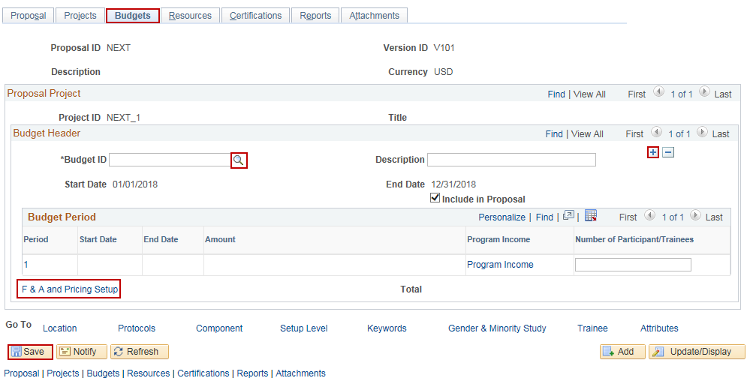
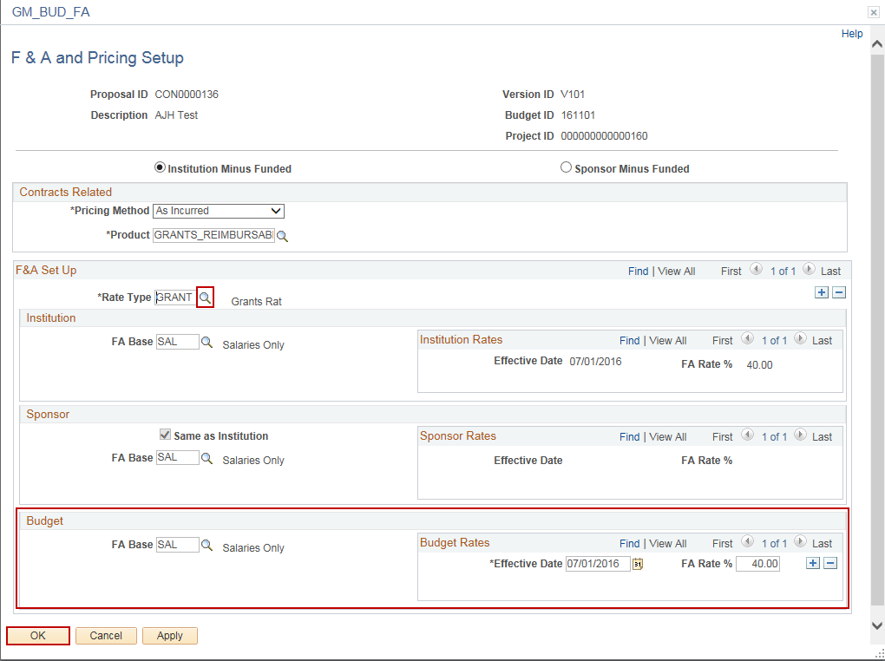
Create a Grant Proposal
Steps | Screenshots
Click on the Budgets tab. Click on the Budget ID lookup icon to select a Budget ID (Activity). To add additional Activities, click on the “+” button and use the lookup to select a Budget ID. Click the Save button. The Budget Periods will populate for the remainder of the project. Click on the F & A and Pricing Setup hyperlink.
Click on the Rate Type lookup to select GRANT as the Rate Type. Verify that the FA Base and Budget Rates are accurate. Click the OK button.

Slide 5
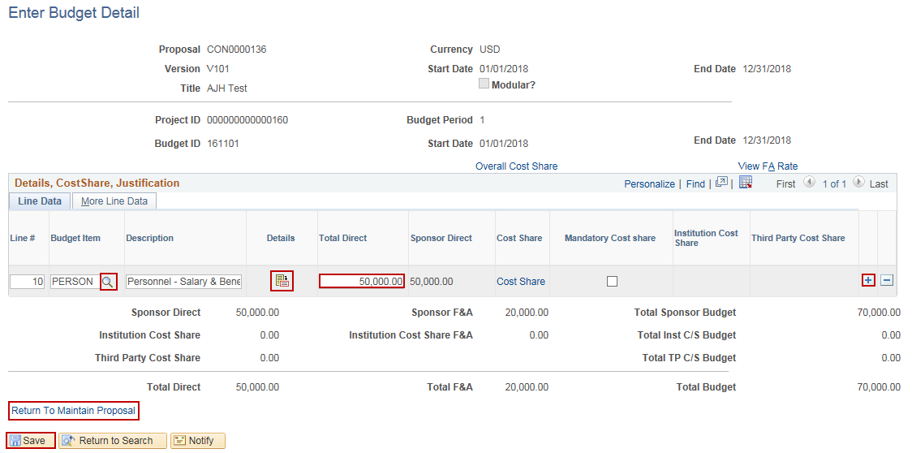
Create a Grant Proposal
Steps | Screenshots
Click the 1 hyperlink to add the budget for that Budget Period for that Activity.
Click on the Budget Item lookup icon to select a Budget Item. Click on the Details icon to enter in Details about the Budget Item or enter in a high-level Total Direct amount. Click the “+” button to add additional Budget Items for that Activity and repeat steps 37-38. Click the Save button. The totals for that Budget Item will display below. Click the Return to Maintain Proposal hyperlink.

Slide 6
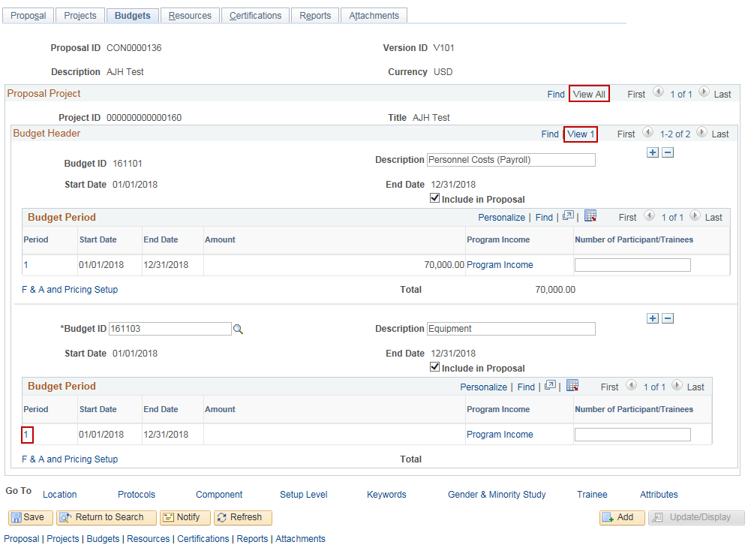
Create a Grant Proposal
Steps | Screenshots
If multiple Budget IDs were created, in the Budget Header section, click the View All hyperlink to view multiple Budget IDs. If multiple Projects were created, in the Proposal Project section, click the View All hyperlink to view multiple projects. If multiple Budget IDs, Budget Periods or Projects were created, repeat steps 36-41 as needed to continue entering a budget.

Slide 7
Create a Grant Proposal
Steps | Screenshots
Click on the Resources tab. In the Resource section, click the Type lookup icon to select a Resource Type. Enter in Comments.
In the Professional section, the PI will automatically display from the Proposal tab. Click the “+” button to add additional Professionals. If Workflow is being used, there needs to be rows assigned for each role in the Workflow (ex. Principal Investigator, Branch/Section Chief, Fiscal Officer, etc.) Click the Employee ID lookup icon to select the employee. Click the Other Role lookup icon to select the employee’s role in the proposal. Click the Workflow Eligible checkbox if the employee should be included in the Workflow. Repeat steps 49-52 as needed for all key Professionals involved with this Grant Proposal. Click the Save button.

Slide 8
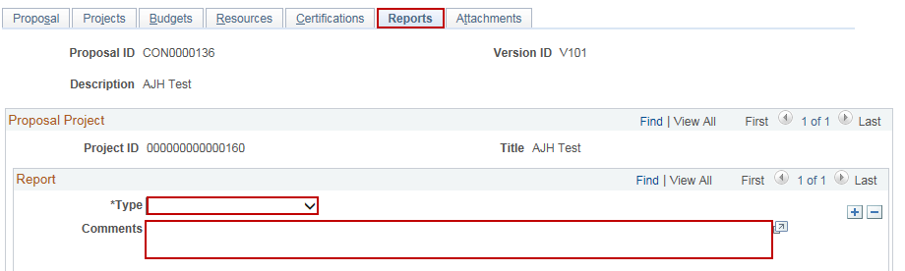
Create a Grant Proposal: Optional Pages
Steps | Screenshots
Optional: To enter Certifications, click on the Certifications tab. Click on the Certification Code lookup icon to select the Certification type. Enter additional information in the Certification Date, Indicator, Certified By, Approval Date, Expiration Dt, Assurance Number and Exemption Number fields.
Optional: To notify anyone viewing the proposal that a report is required, click on the Reports tab. Select a Report Type from the dropdown menu. Enter in Comments.
Optional: To add an attachment to the proposal, click on the Attachments tab. Click on the paperclip icon and follow the prompts to add an attachment.

Slide 9
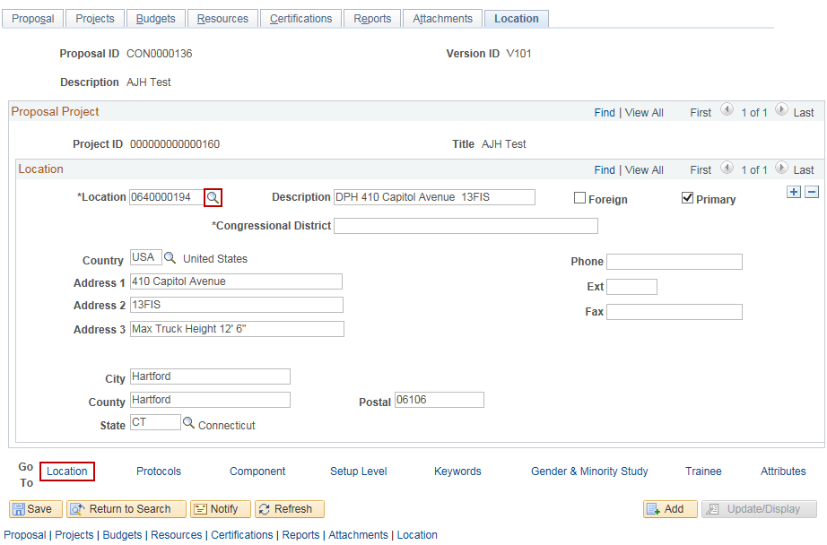
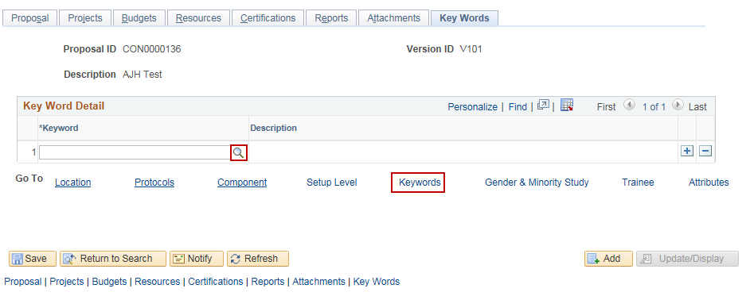
Create a Grant Proposal: Optional Pages
Steps | Screenshots
Optional: To view or update the project location, click on the Location hyperlink. Click on the Location lookup icon to select a different location.
Optional: To add keywords to the proposal, click on the Keywords hyperlink. Click on the Keyword lookup icon to select a keyword.

