Slide 1
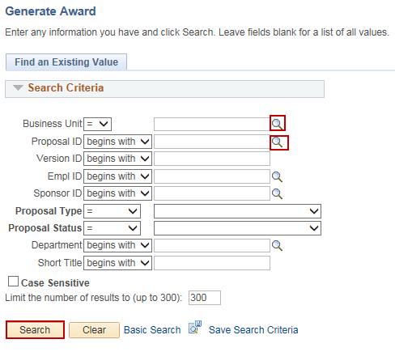
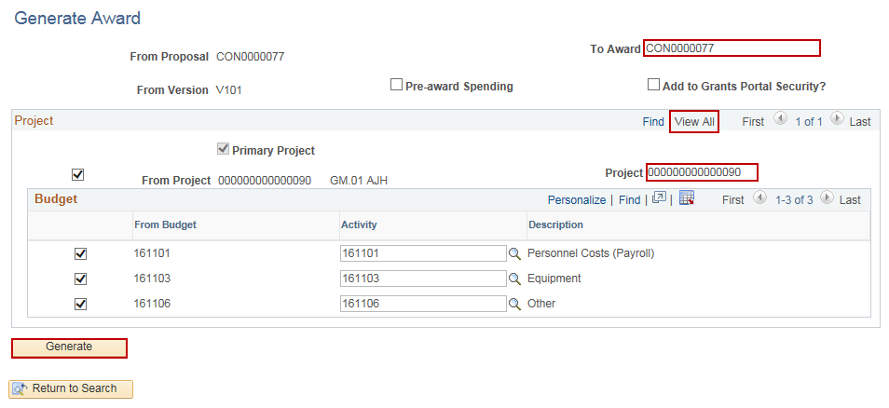
Generate Award
Purpose:
This job aid will help you generate an award for an awarded grant in Core-CT.
Steps | Screenshots
Navigate to the Generate Award page: Main Menu > Core-CT Financials > Grants > Proposals > Generate Award
Use the lookup icon to select a valid Business Unit. Use the lookup icon to select a valid Proposal ID or enter in any other search criteria. Click the Search button.
Optional: Enter in a valid contract value in the To Award field. Click the View All hyperlink if there are multiple projects corresponding to this proposal. Update the Project ID in the Project field. The Project must begin the first three digits with the agency abbreviation (ex. DPH). Verify the From Budget rows will transfer to the accurate Activity row. Use the lookup icons to change values, if necessary. Click the Generate button. The user must have the security role to add projects and create contracts in Core-CT.

Slide 2
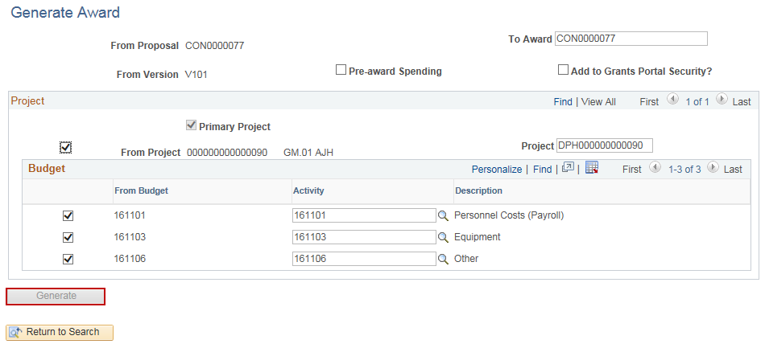
Generate Award
Steps | Screenshots
The Generate button will grey out once clicked. Note: If an error occurs while the system is processing, click the Return to Search button, search for the proposal again. Update any necessary values and click the Generate button again.

