Slide 1
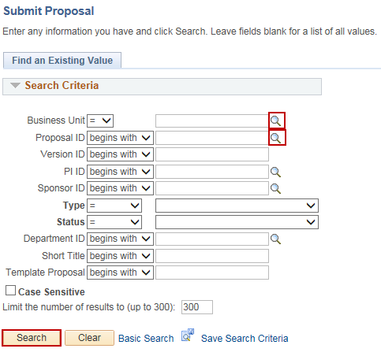
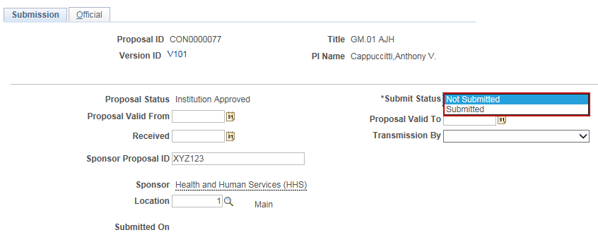
Submit a Grant Proposal
Purpose:
This job aid will help you submit a Grant Proposal in Core-CT.
Steps | Screenshots
Navigate to the Submit Proposal page: Main Menu > Core-CT Financials > Grants > Proposals > Submit Proposal
Use the lookup icon to select a valid Business Unit. Click the Proposal ID lookup icon to select a valid proposal or enter any other search criteria. Click the Search button.
Select Submit from the Submit Status dropdown menu.

Slide 2
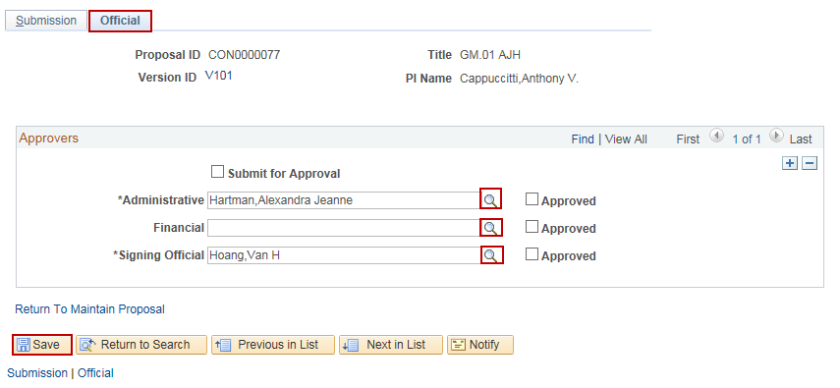
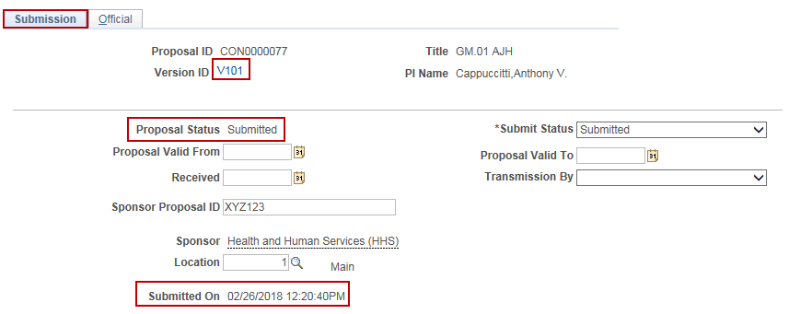
Submit a Grant Proposal
Steps | Screenshots
Click the Official tab. Use the lookup icons to select the Administrative, Financial and Signing Official employees for the proposal. Click the Save button.
Click the Submission tab. The Proposal Status displays Submitted and the Submitted On date and timestamp have updated. Click on the Version ID hyperlink to navigate to the proposal.

Slide 3
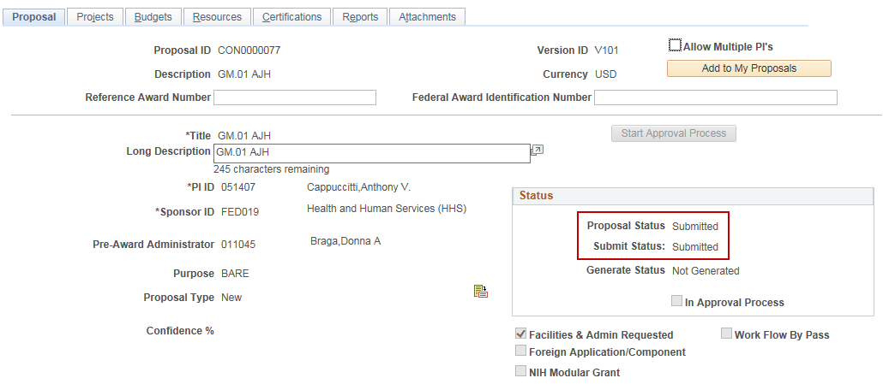
Submit a Grant Proposal
Steps | Screenshots
The Proposal Status and the Submit Status have updated to display Submitted.

