Slide 1
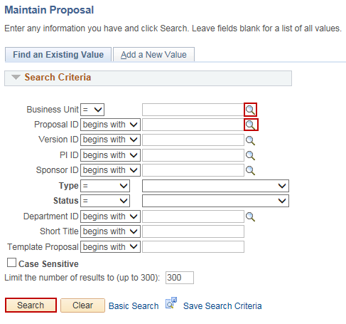
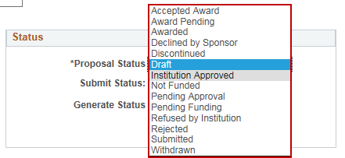
Update Proposal Status
Purpose:
This job aid will help you update the status of a Grant Proposal in Core-CT.
Steps | Screenshots
Navigate to the Maintain Proposal page: Main Menu > Core-CT Financials > Grants > Proposals > Maintain Proposal
Use the lookup icon to select a valid Business Unit. Use the lookup icon to select a valid Proposal ID or enter any other search criteria. Click the Search button.
In the Status section, select a valid Proposal Status from the dropdown menu.
Click the Save button.

